Slide 1
Causal Discovery for Trustworthy AI
Fabrizio Russo
7/02/2025 – Lloyds Banking Group Summer School

Slide 2
Talk Overview
My Journey
Motivation & Background
Causal Models
Causal Discovery
Causal Graphs for Contestable Neural Networks
Causal Discovery with Shapley Values
Argumentative Causal Discovery
Conclusion

Slide 3
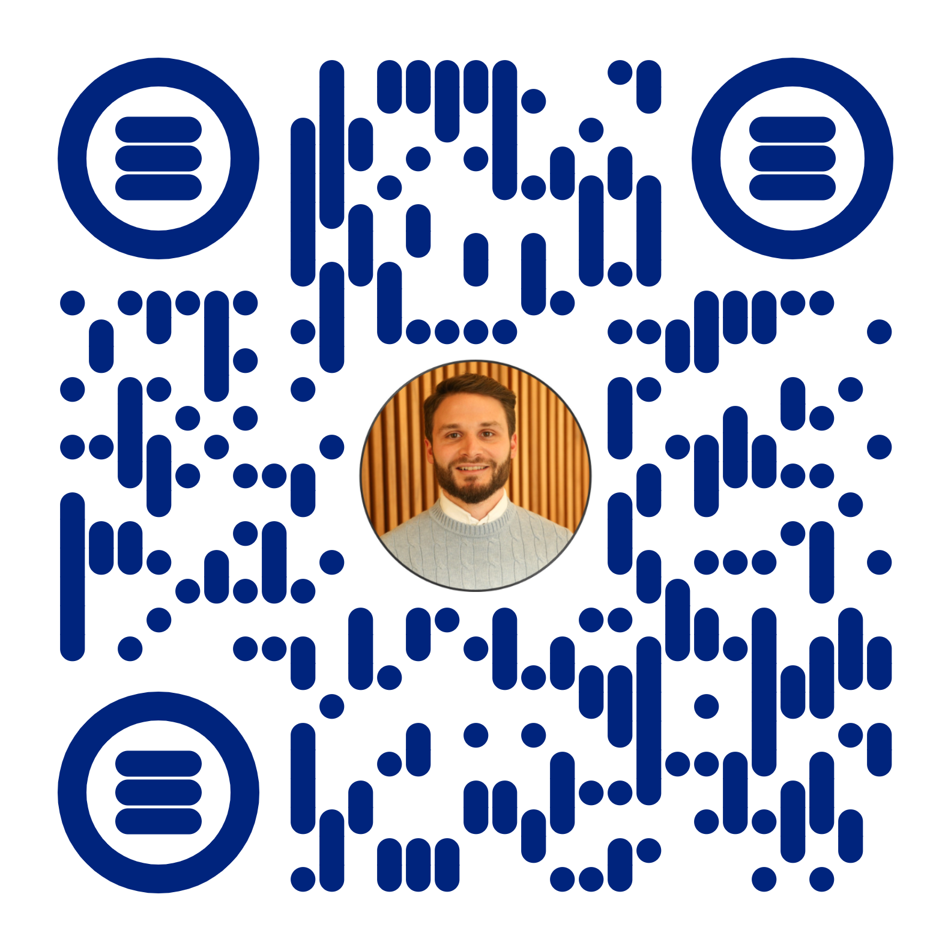
My Journey
Across Finance And Artificial Intelligence
2009-2012 Rome – Tor Vergata: BSc Economics & Finance
Madrid – Autónoma
2013-2014 London: Exploring
2014-2020 London: General Electric Capital & 4most Europe
- Credit Risk Analyst
- Credit Risk Consultant
- Managing Consultant
- Head of Data Science
2016-2018 London – Birkbeck College: MSc Applied Statistics
2020-2024 London – Imperial College: PhD Safe and Trusted AI
2025-Present London – Imperial College: Research Associate
Scan to Website

Slide 4
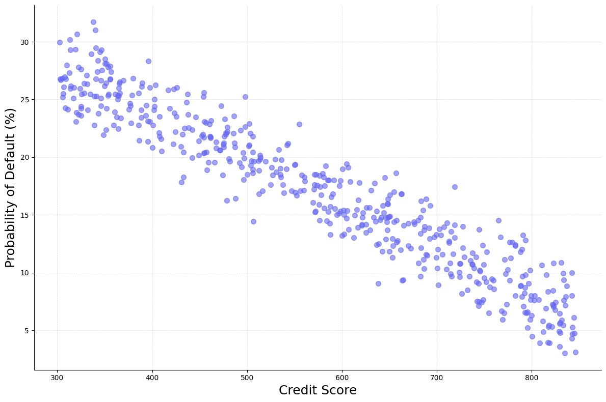
Causal Models
Motivation
Predictive Models
What if we observe a credit score of 700?
What if we observe a PD of 12%?
Credit Worthiness
Credit Score
Economy
PD
Job Security
Indebtedness
Score> 700
Causal Models
What if we “intervene” on the Credit Score?
What’s the effect on the PD?
12

Slide 5
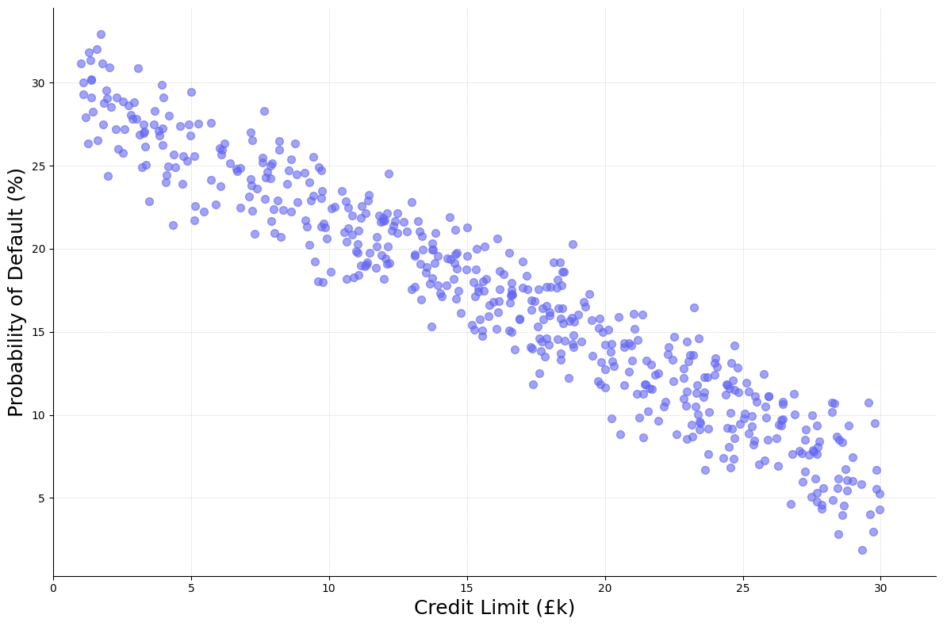
Causal Models
Motivation
Predictive Models
What if we observe a credit limit of £25k?
What if we observe a PD of 9%?
Credit Worthiness
Credit Score
Credit Limit
PD
Indebtedness
Credit Limit = £25K
Causal Models
What if we “intervene” on Credit Limit?
What’s the causal effect on the PD?
?
9

Slide 6
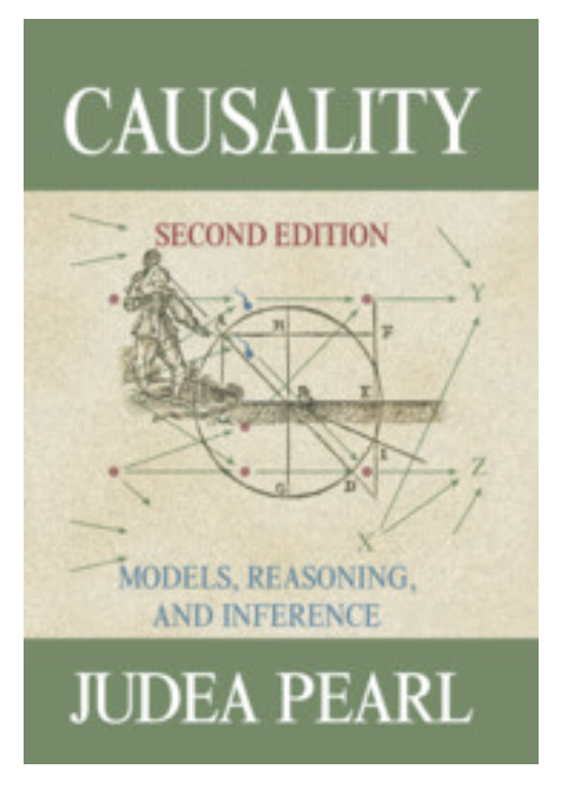

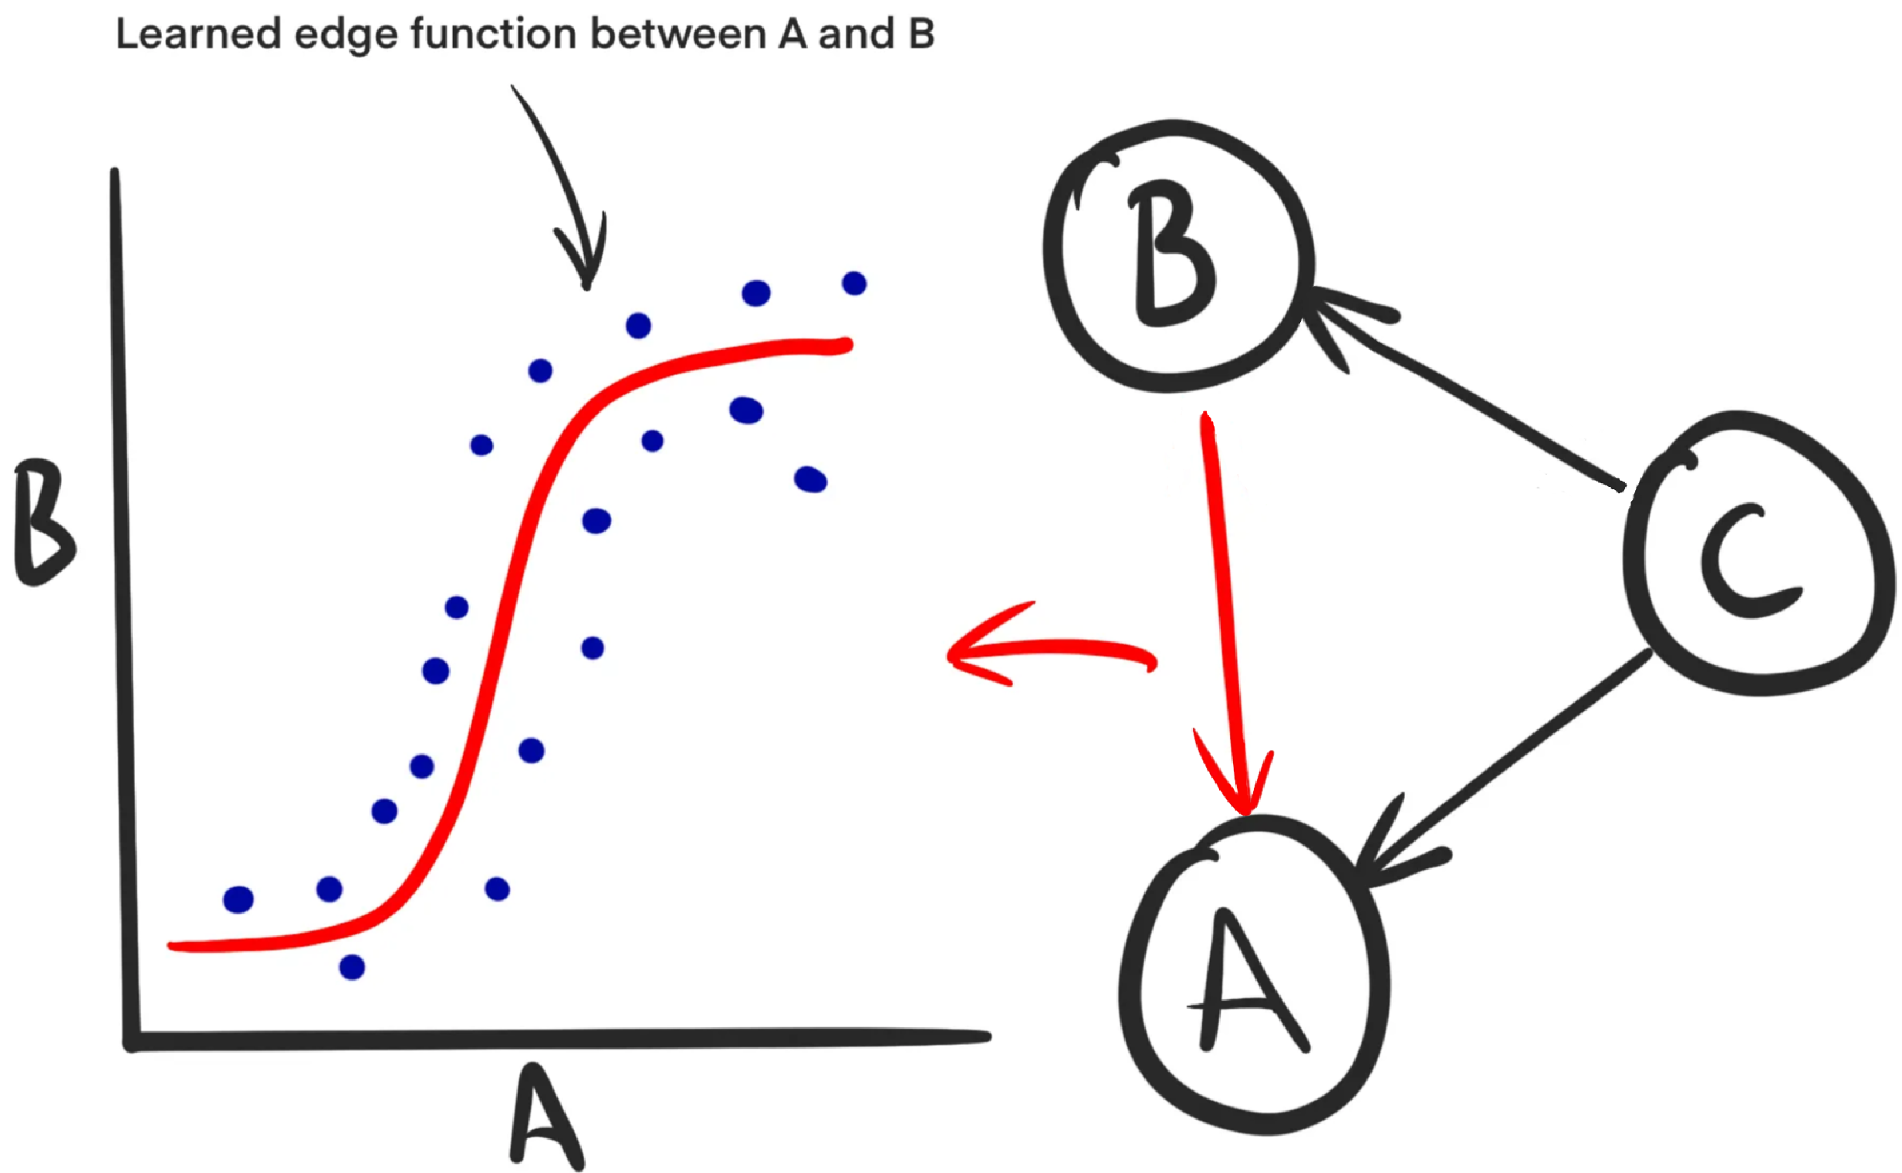

Structural Causal Model (Pearl, 2009)
Graph (Assumptions) + Functions
Image from https://towardsdatascience.com/how-to-understand-the-world-of-causality-c698cdc9f27c

Slide 7
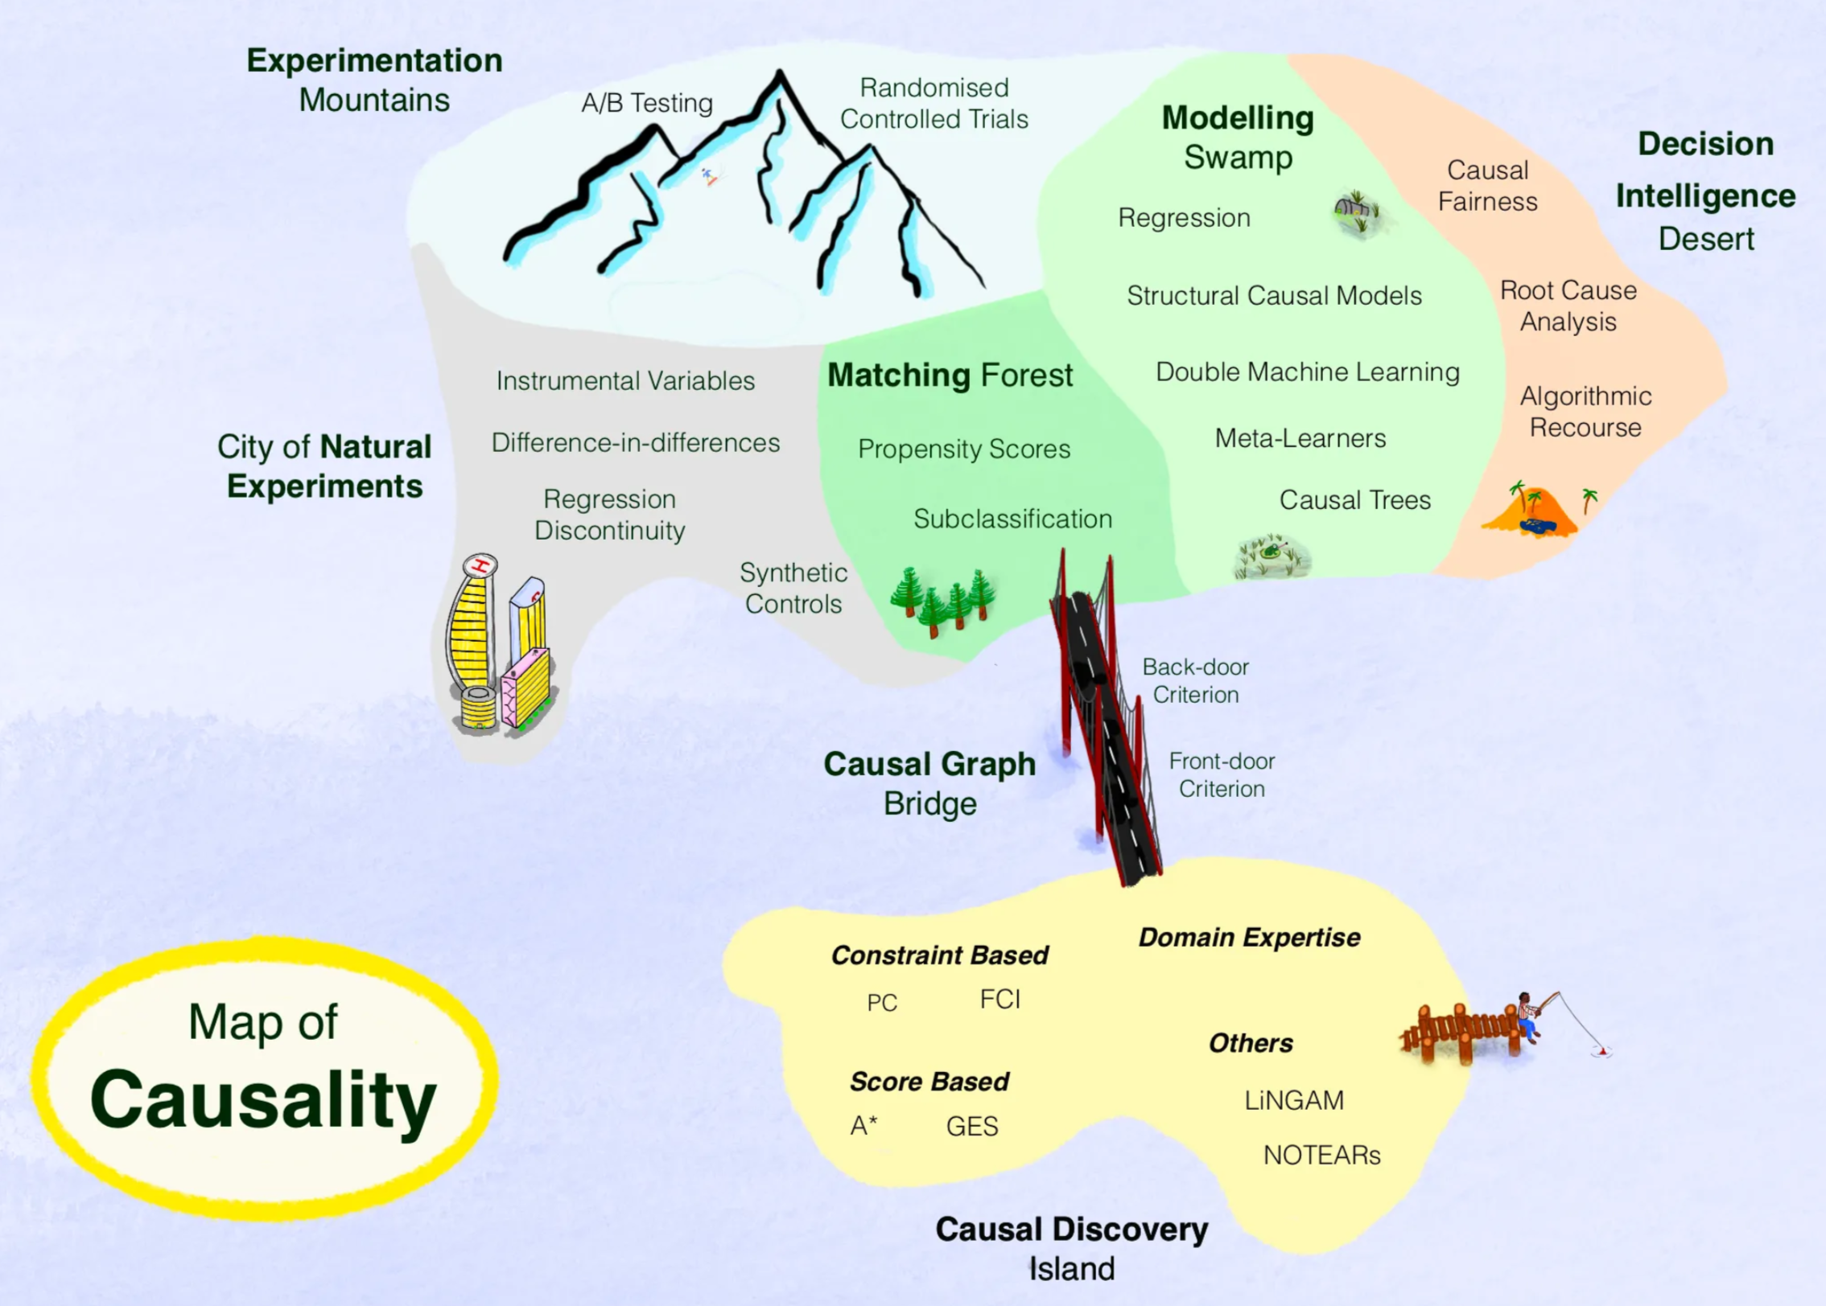
Image from https://towardsdatascience.com/how-to-understand-the-world-of-causality-c698cdc9f27c

Slide 8
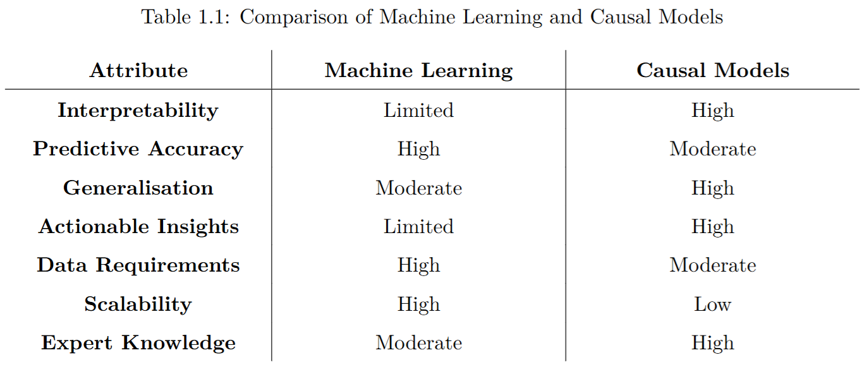
Machine Learning vs Causal Models
High-Level Comparison

Slide 9
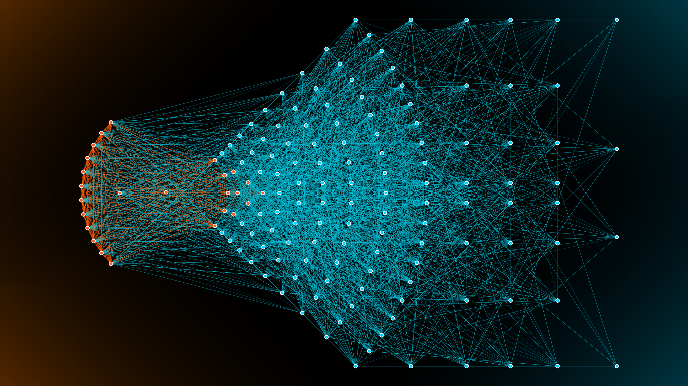
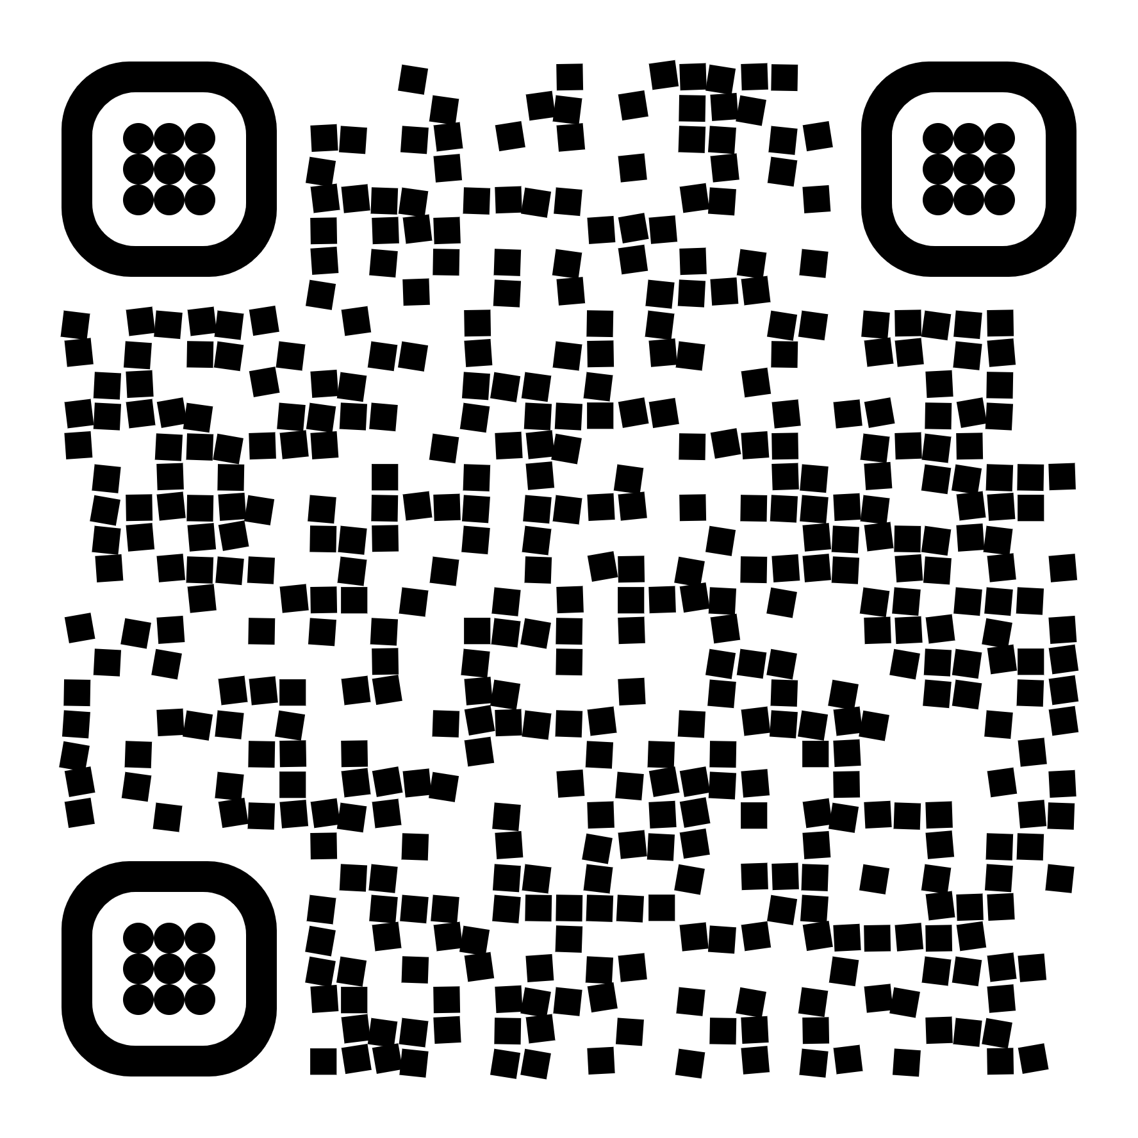
Russo & Toni. Causal Discovery and Knowledge Injection for Contestable Neural Networks. In Proc. of ECAI 2023
Contestable Neural Networks
Causal Discovery for XAI &
Human-in-the-loop Debugging
9
07/07/2025

Slide 10
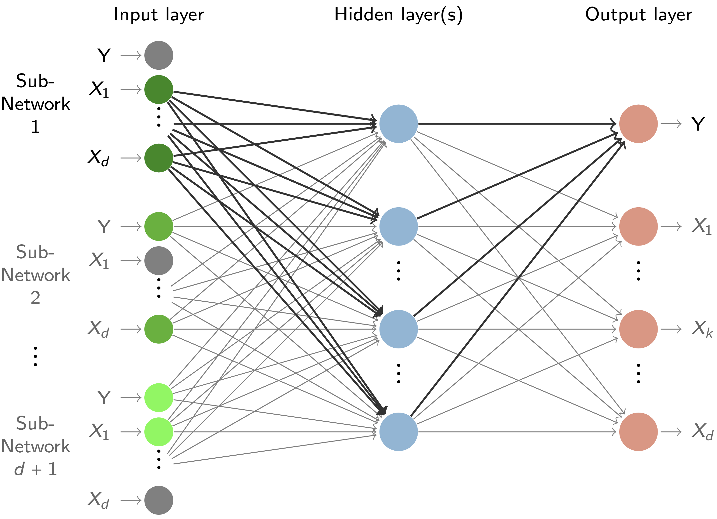
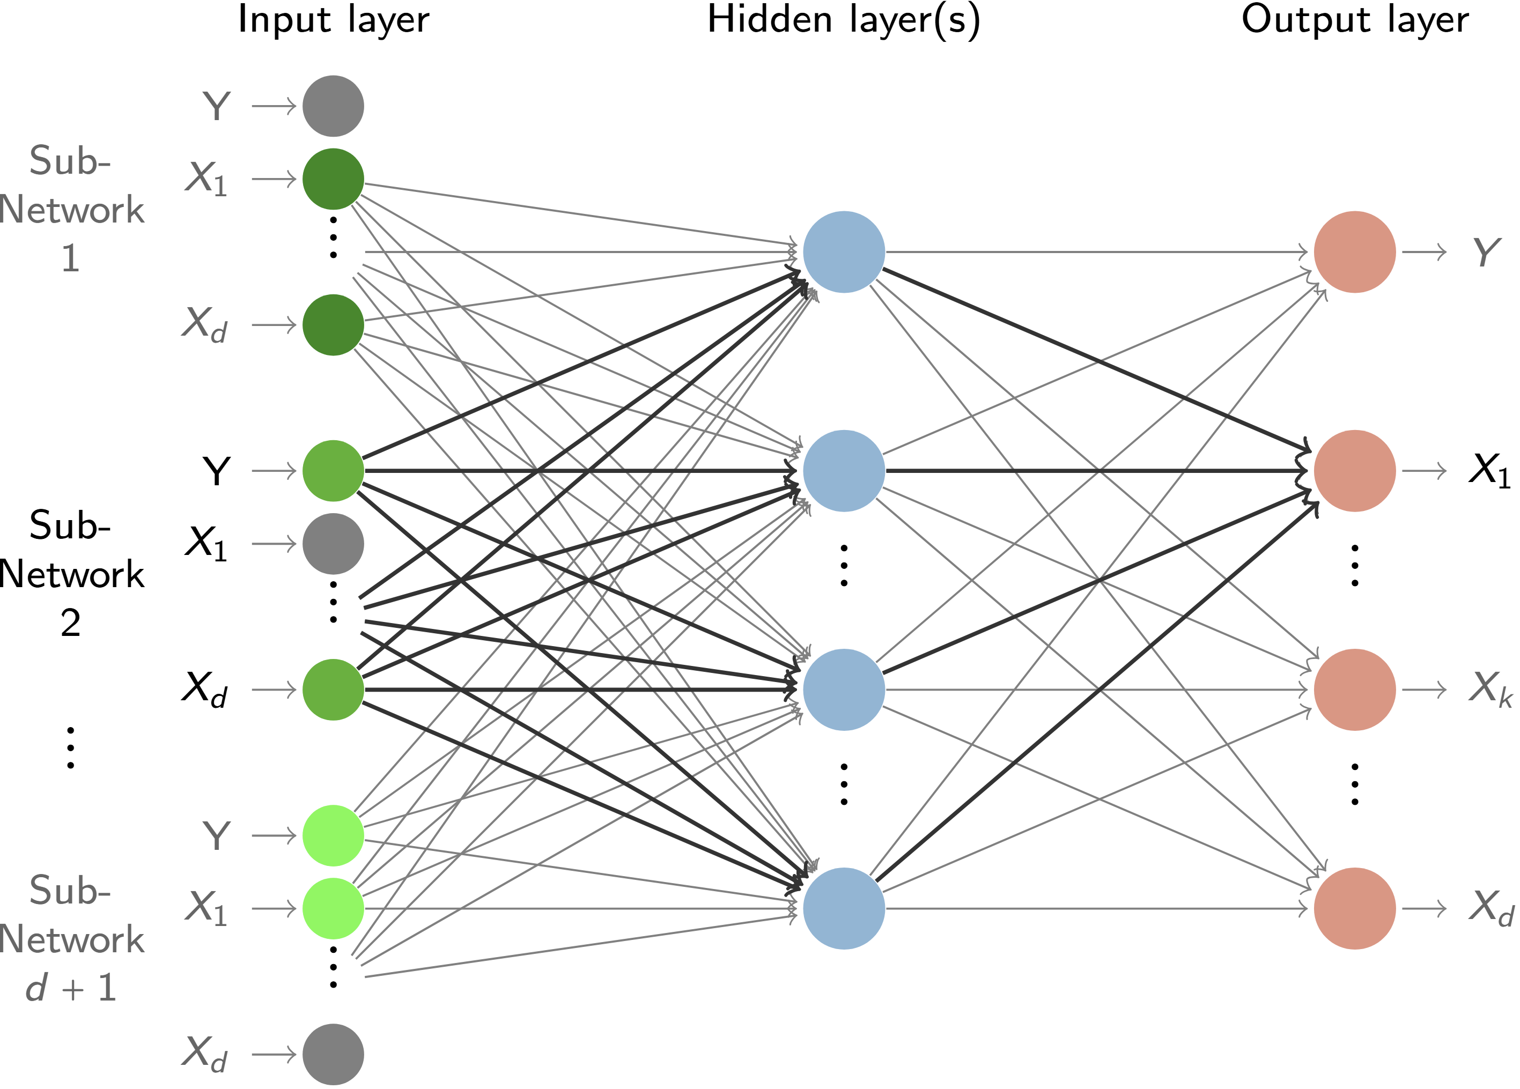
Joint Neural Network Structure
(Kyono, Zhang and van der Schaar 2020)

Slide 11
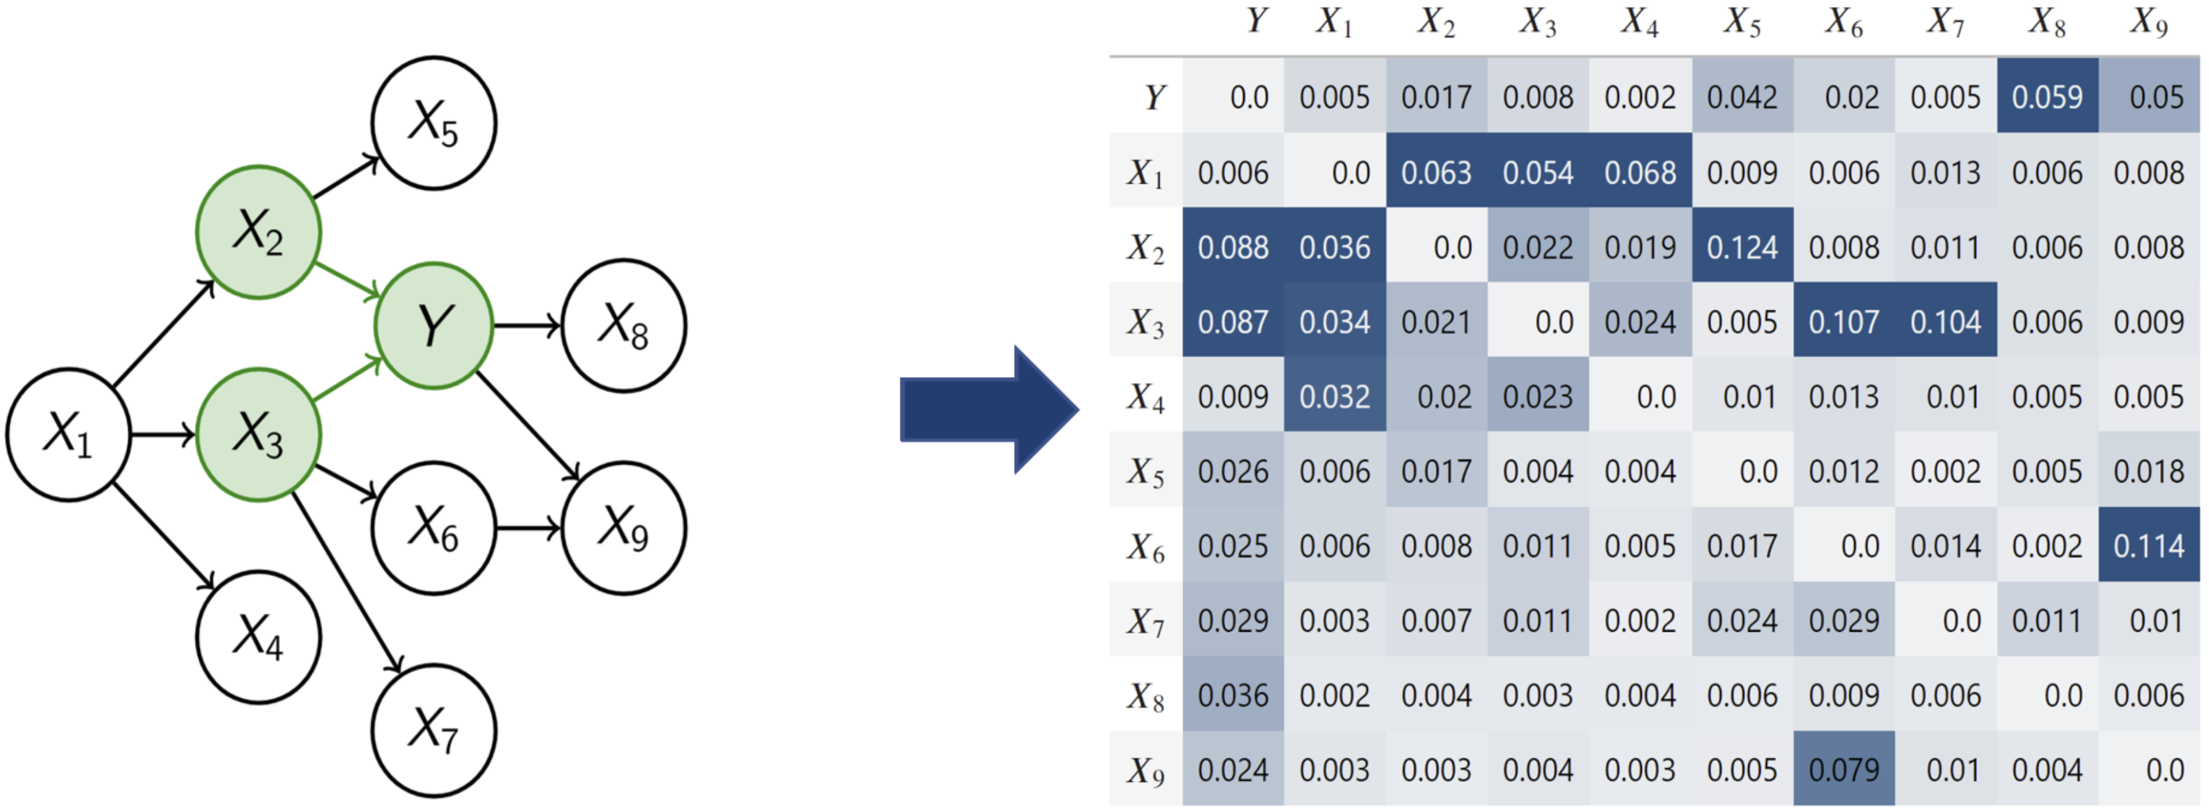
Objective
Capture Causal Relations

Slide 12
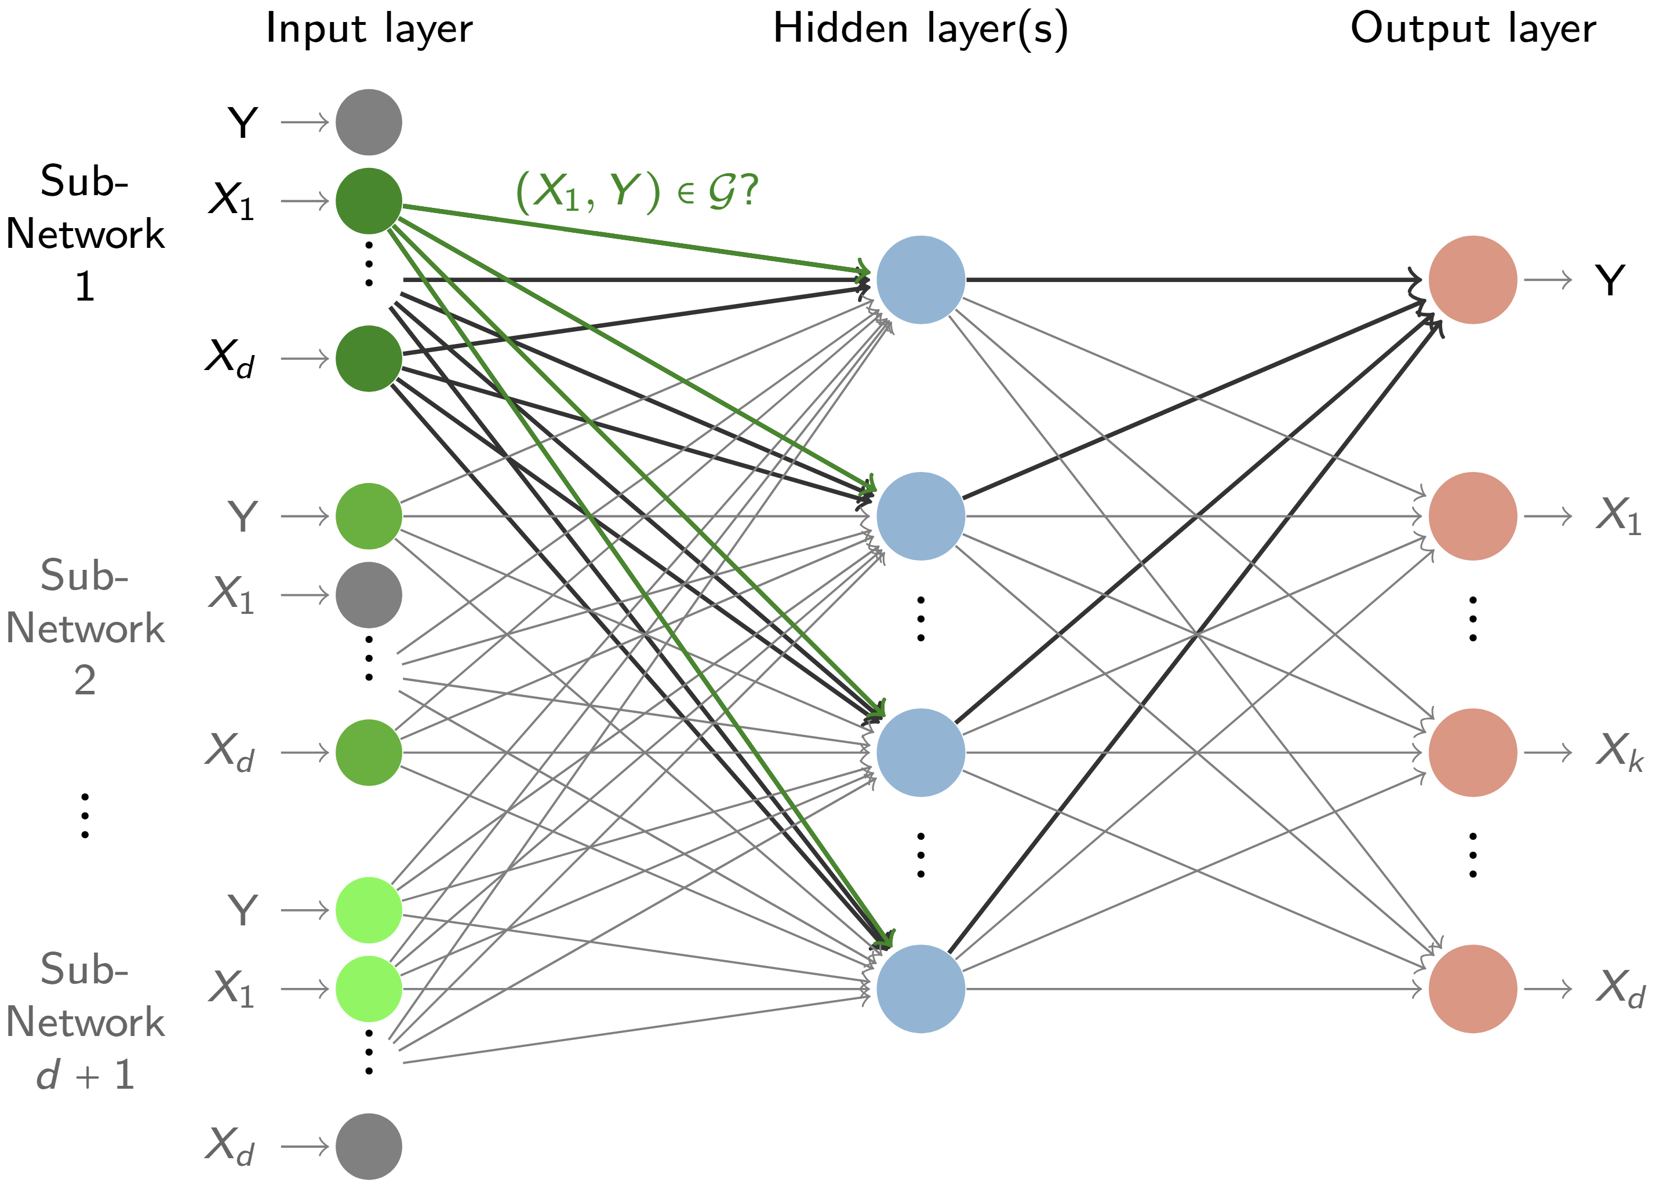
Encode Causality in the Network Structure
(Kyono, Zhang and van der Schaar 2020)

Slide 13
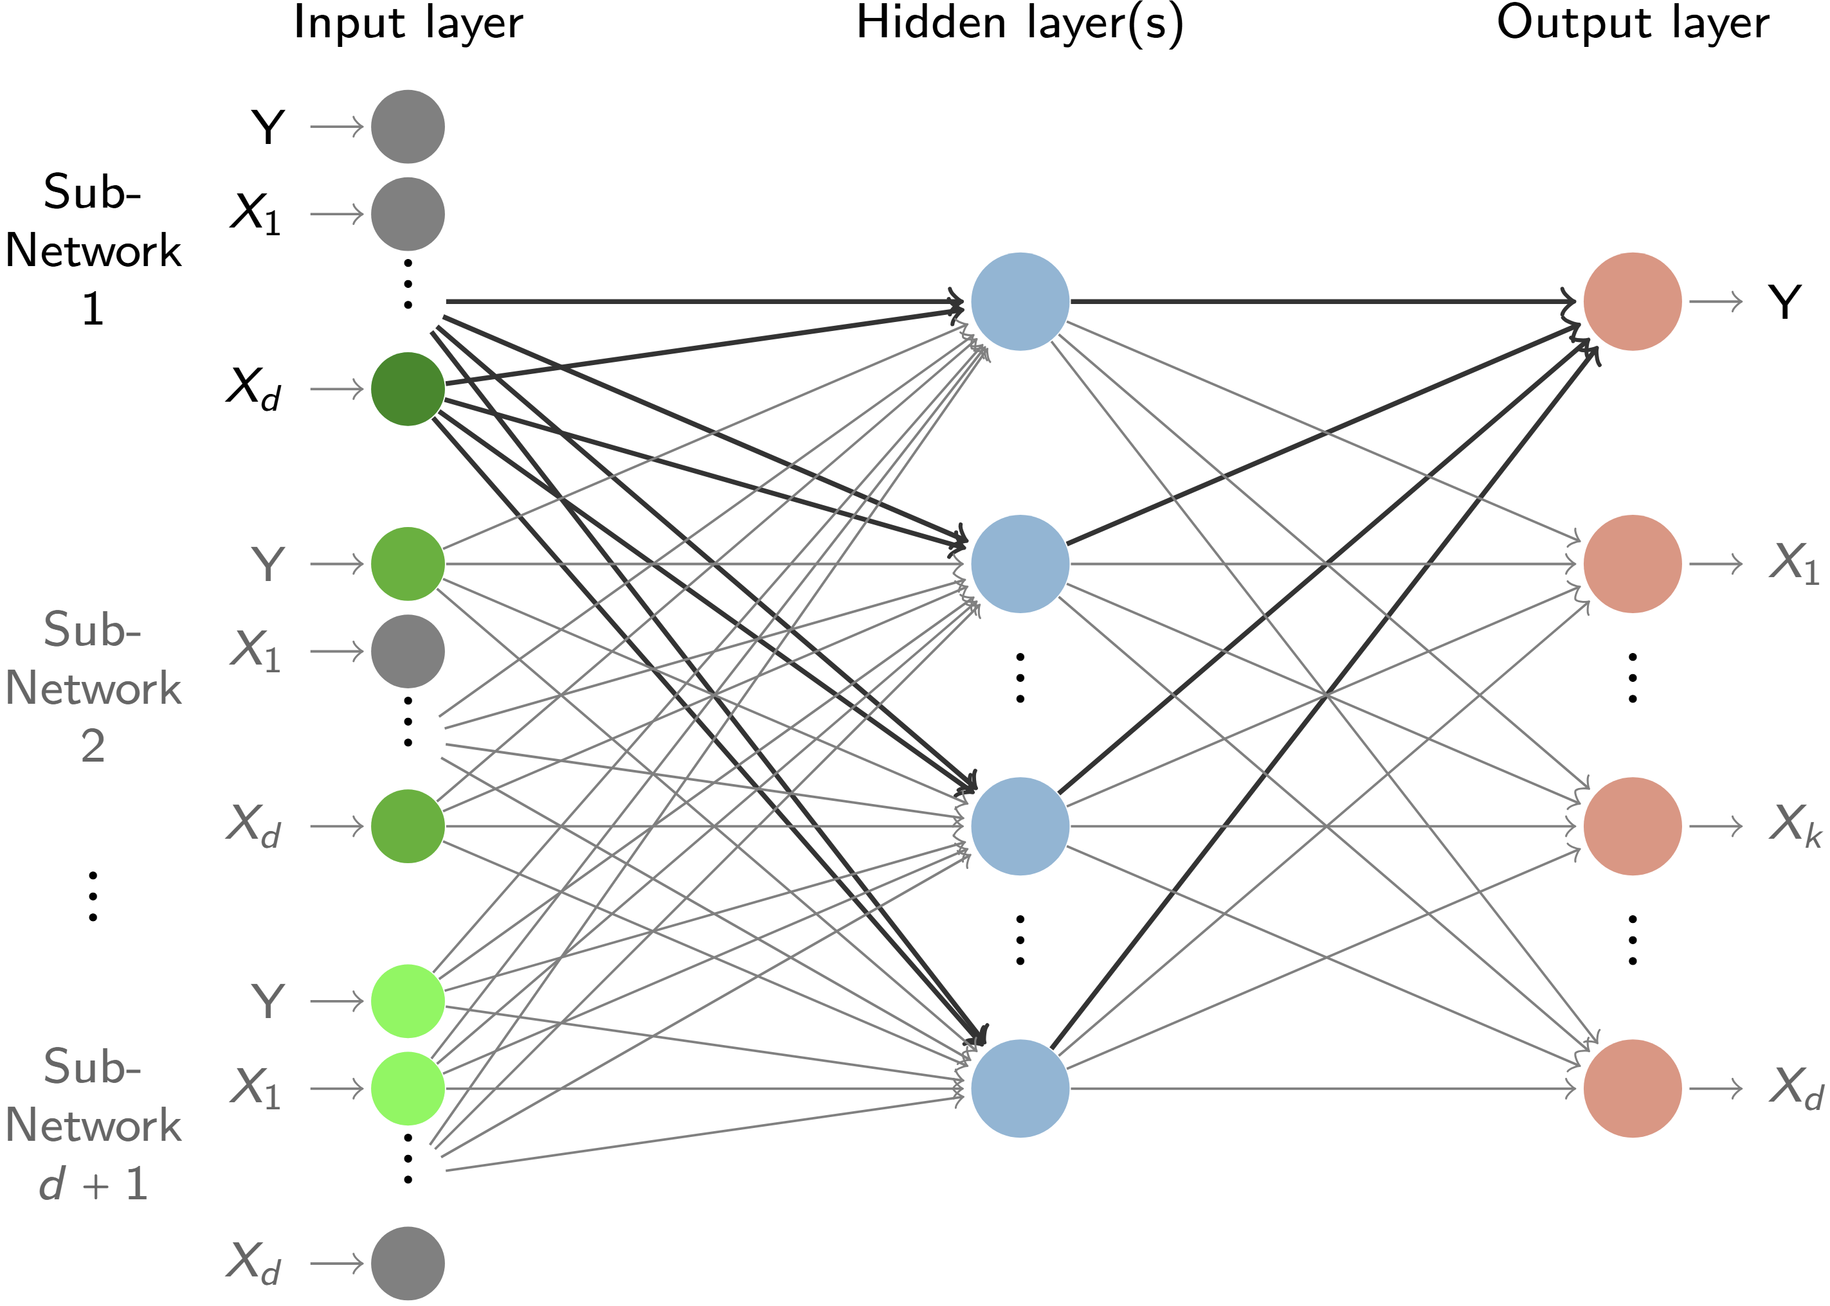
Encode Causality in the Network Structure
(Kyono, Zhang and van der Schaar 2020)

Slide 14
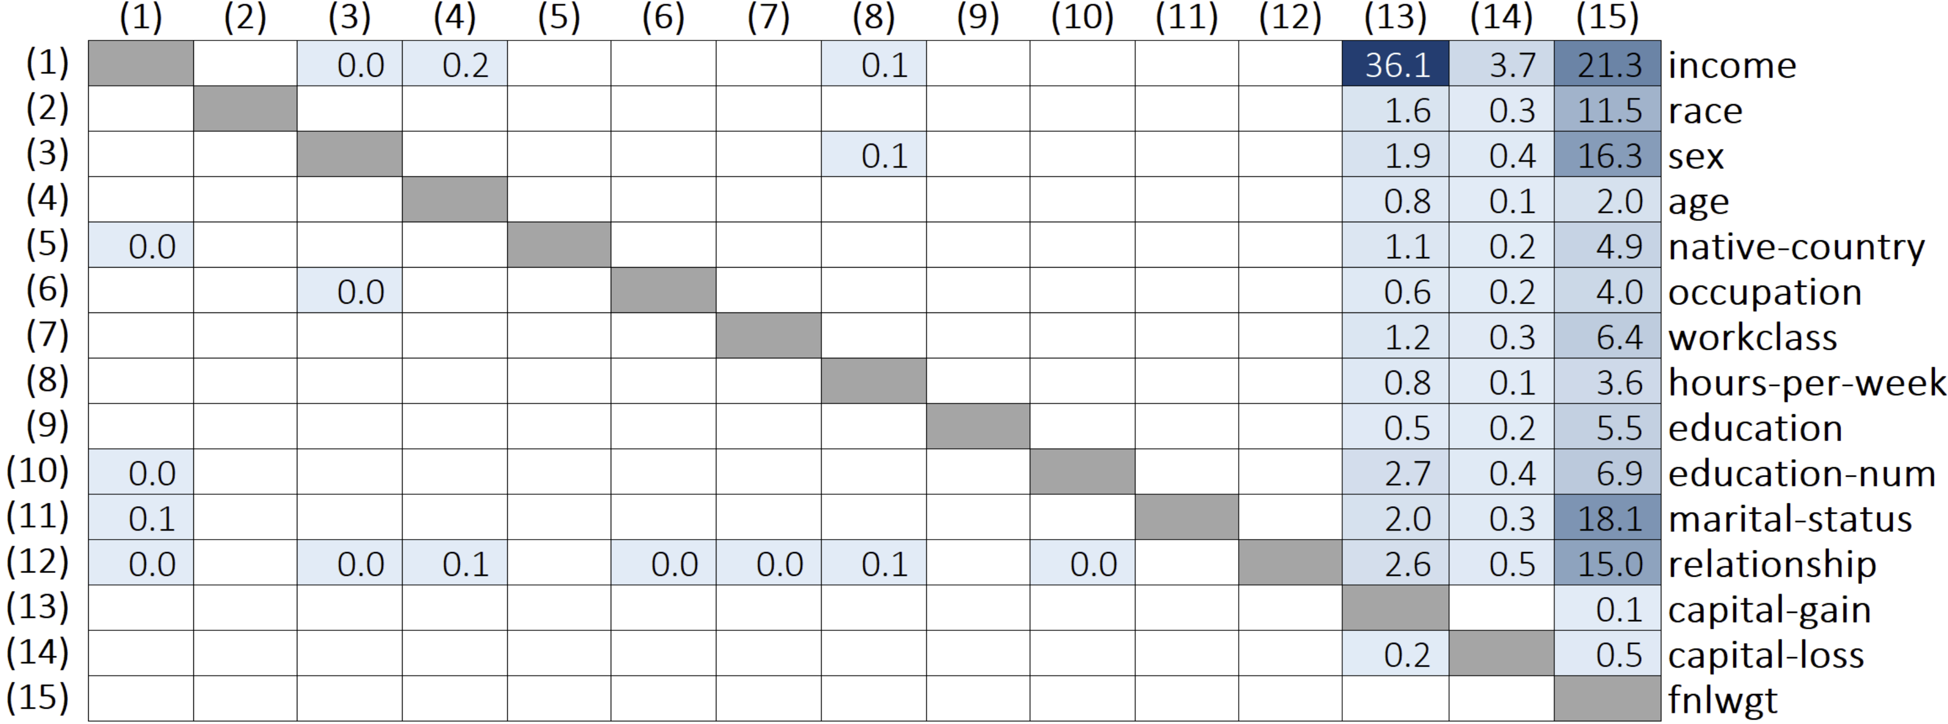
Income Prediction Case Study
Adult Dataset (Becker and Kohavi, 1996)

Slide 15
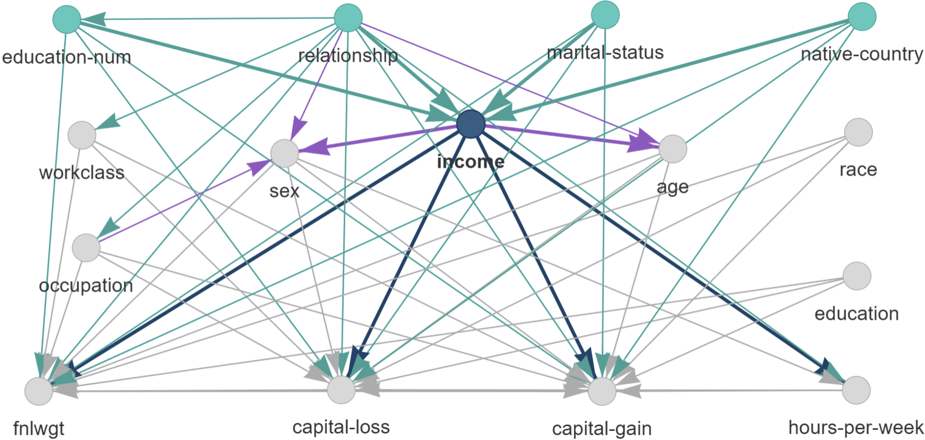
Income Prediction Case Study
Adult Dataset (Becker and Kohavi, 1996)

Slide 16
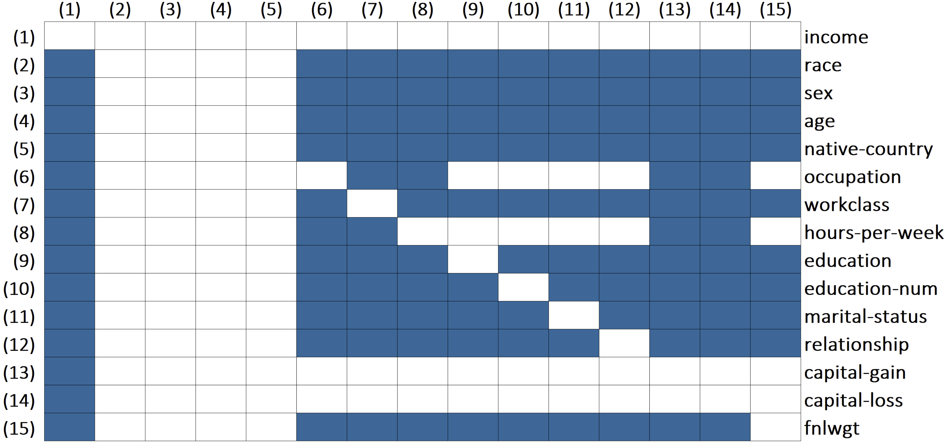
Income Prediction Case Study
Adult Dataset (Becker and Kohavi, 1996)

Slide 17
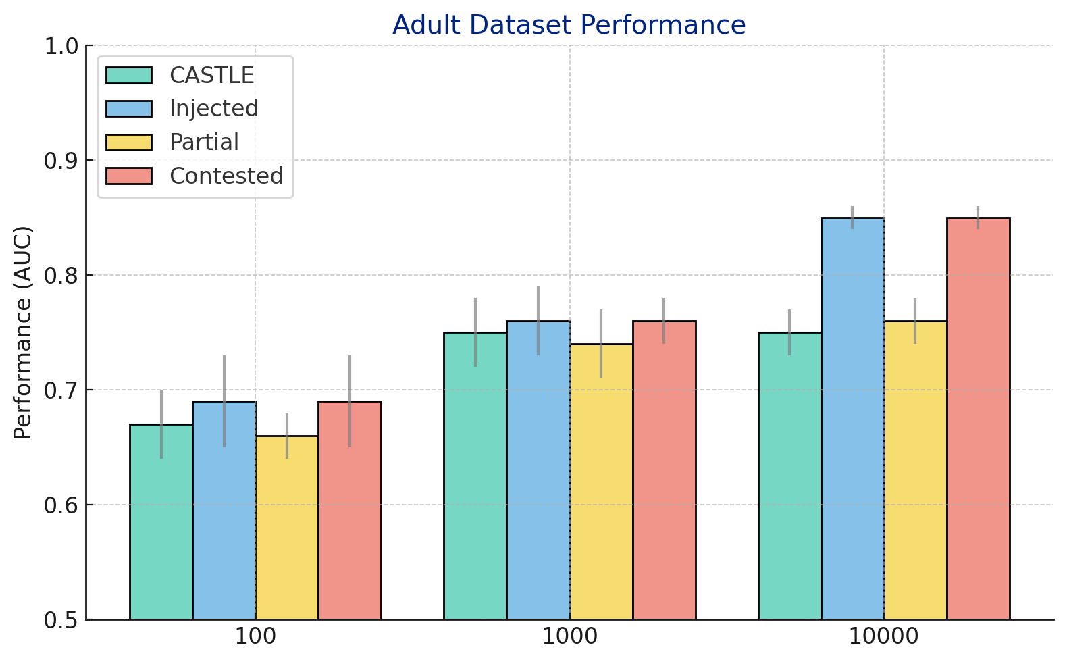
Income Prediction Case Study
Adult Dataset (Becker and Kohavi, 1996)

Slide 18



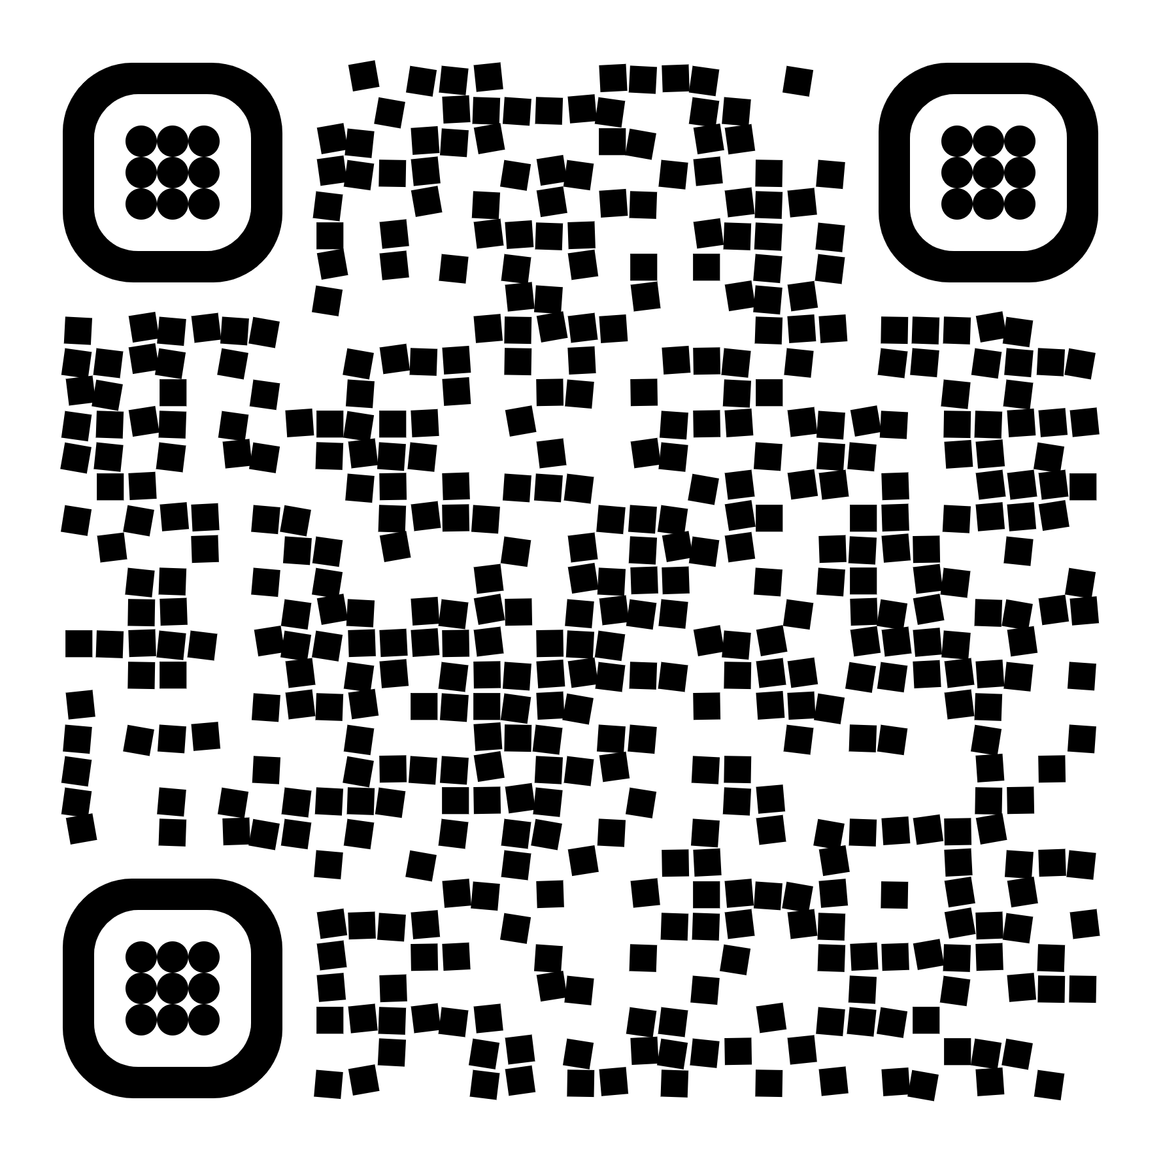
Takeaways
Causal Graphs to…
Explain
Contest
Improve
Russo & Toni. Causal Discovery and Knowledge Injection for Contestable Neural Networks. In Proc. of ECAI 2023

Slide 19
How do we reliably build causal graphs from data?

Slide 20
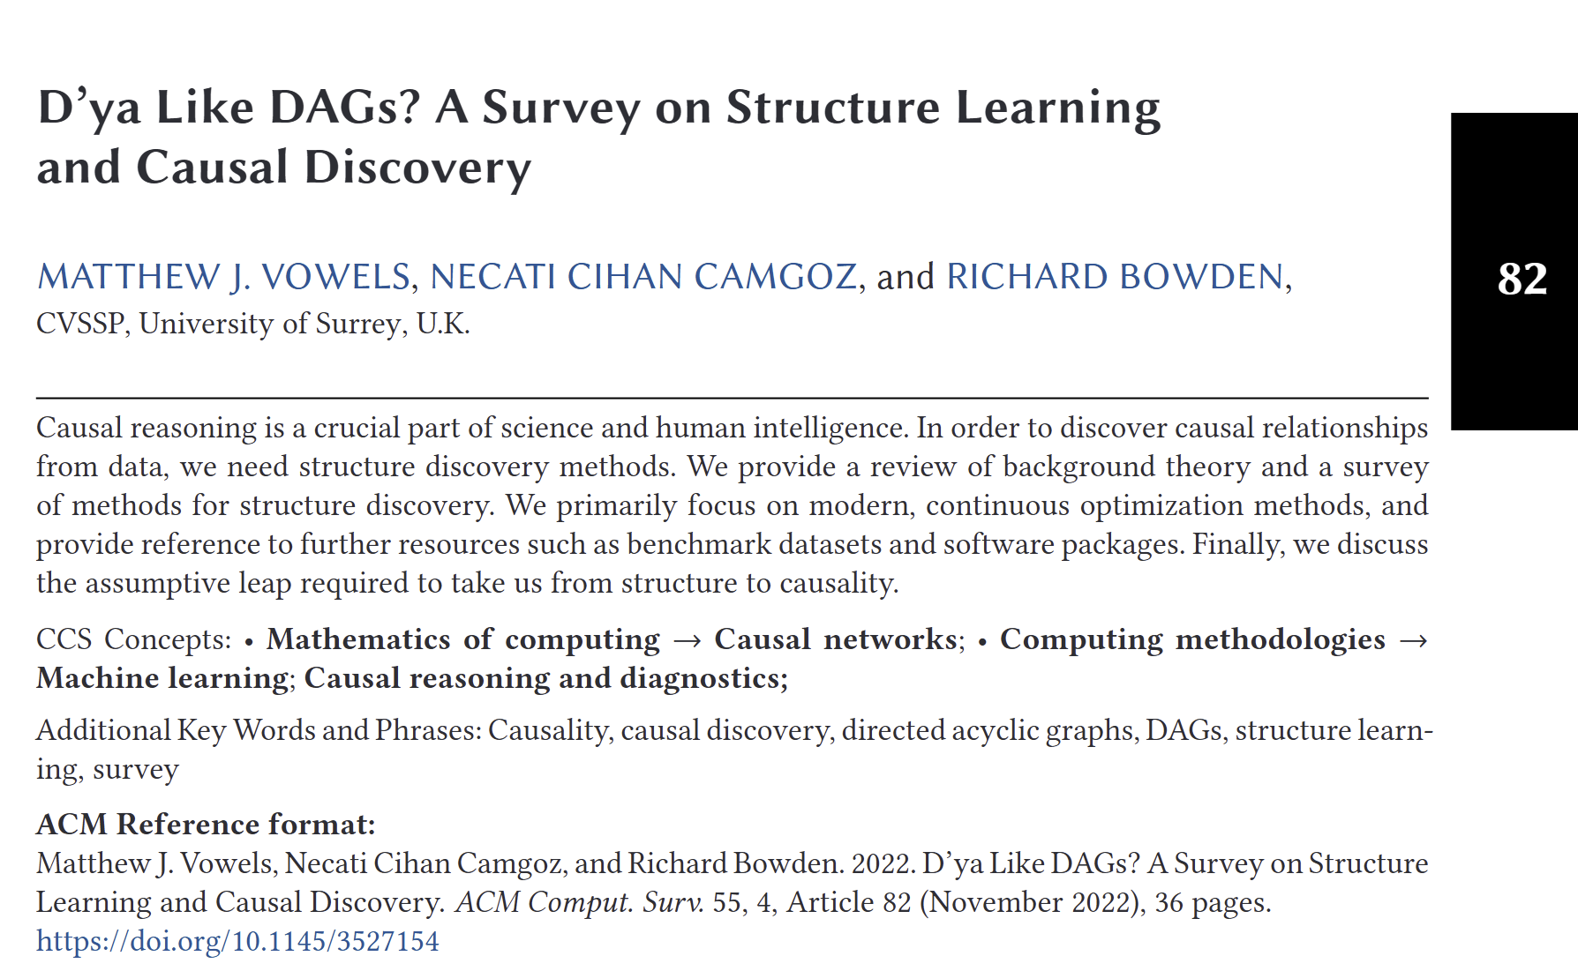
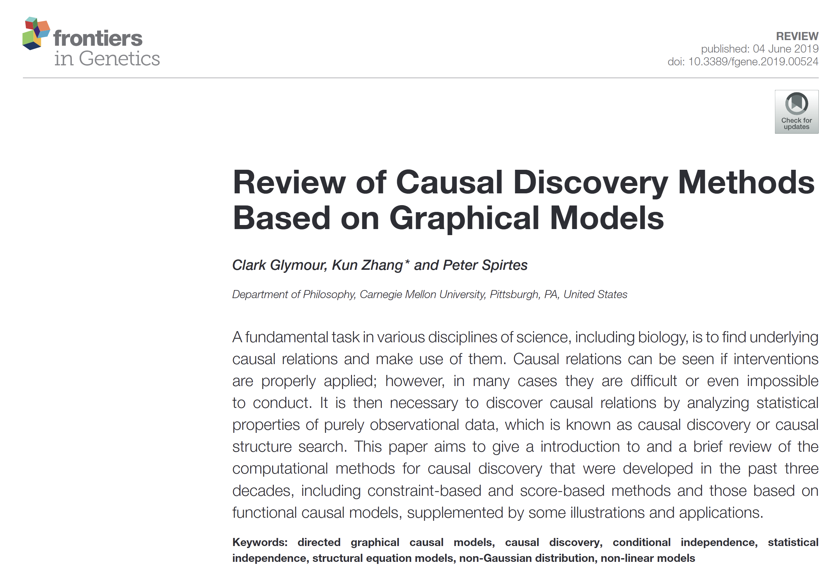
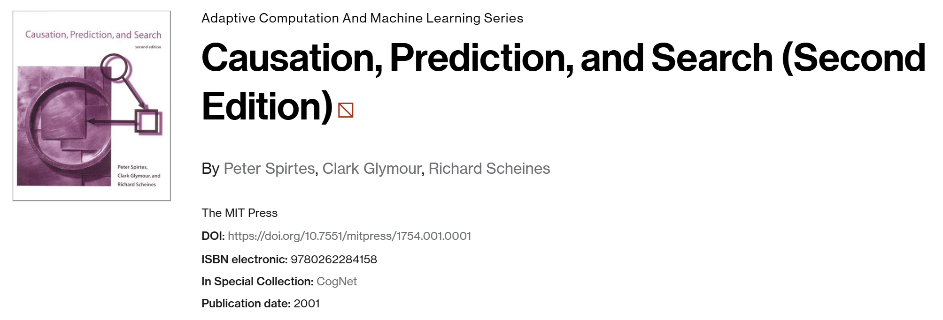
Causal Discovery Literature
From the 90s

Slide 21
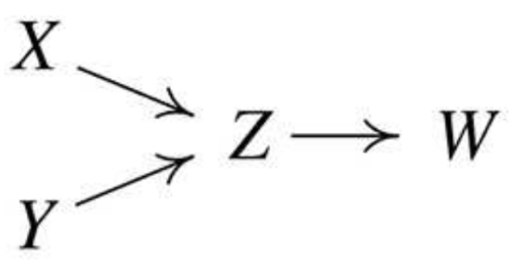
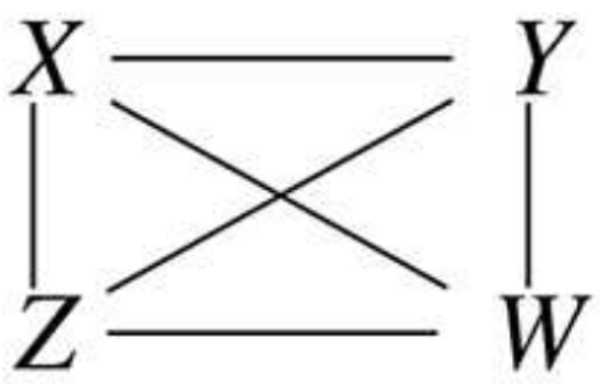
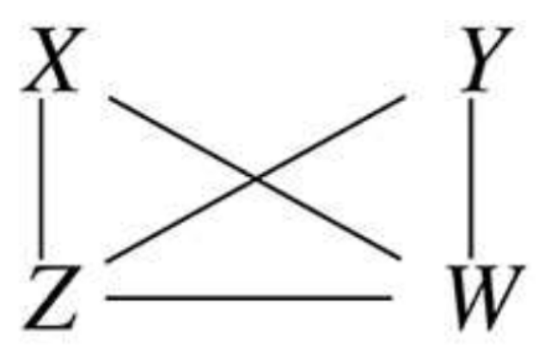
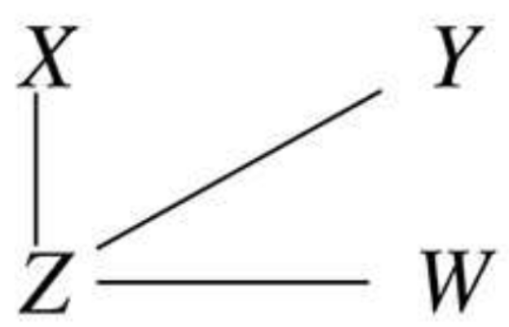



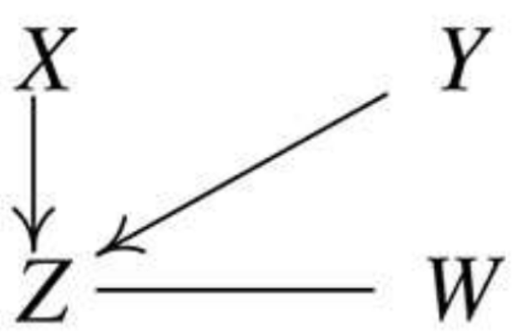
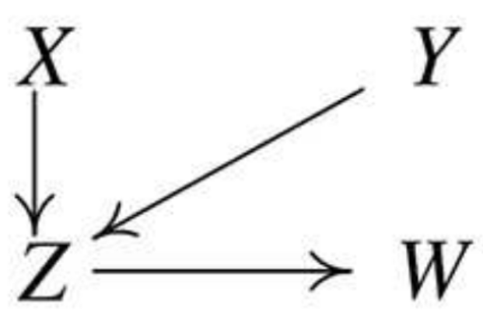

The Peter-Clark Algorithm
(Spirtes et al, 1993) Example from Glymour et al, 2019
True Graph

Slide 22



Peter-Clark Algorithm
Sound & Complete
Efficient
Subject to Statistical Errors
Russo & Toni. Shapley-PC: Constraint-based Causal Structure Learning with a Shapley Inspired Framework. In Proc. of CLeaR 2025

Slide 23
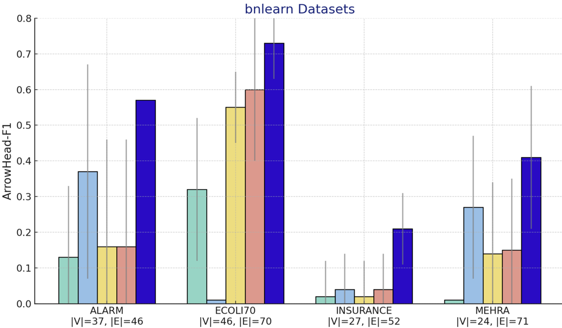
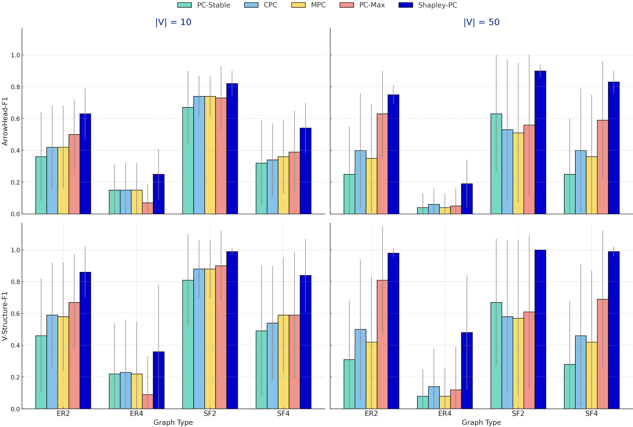
Shapley-PC Reconstructution Accuracy
on bnlearn datasets (Scutari, 2014)

Slide 24
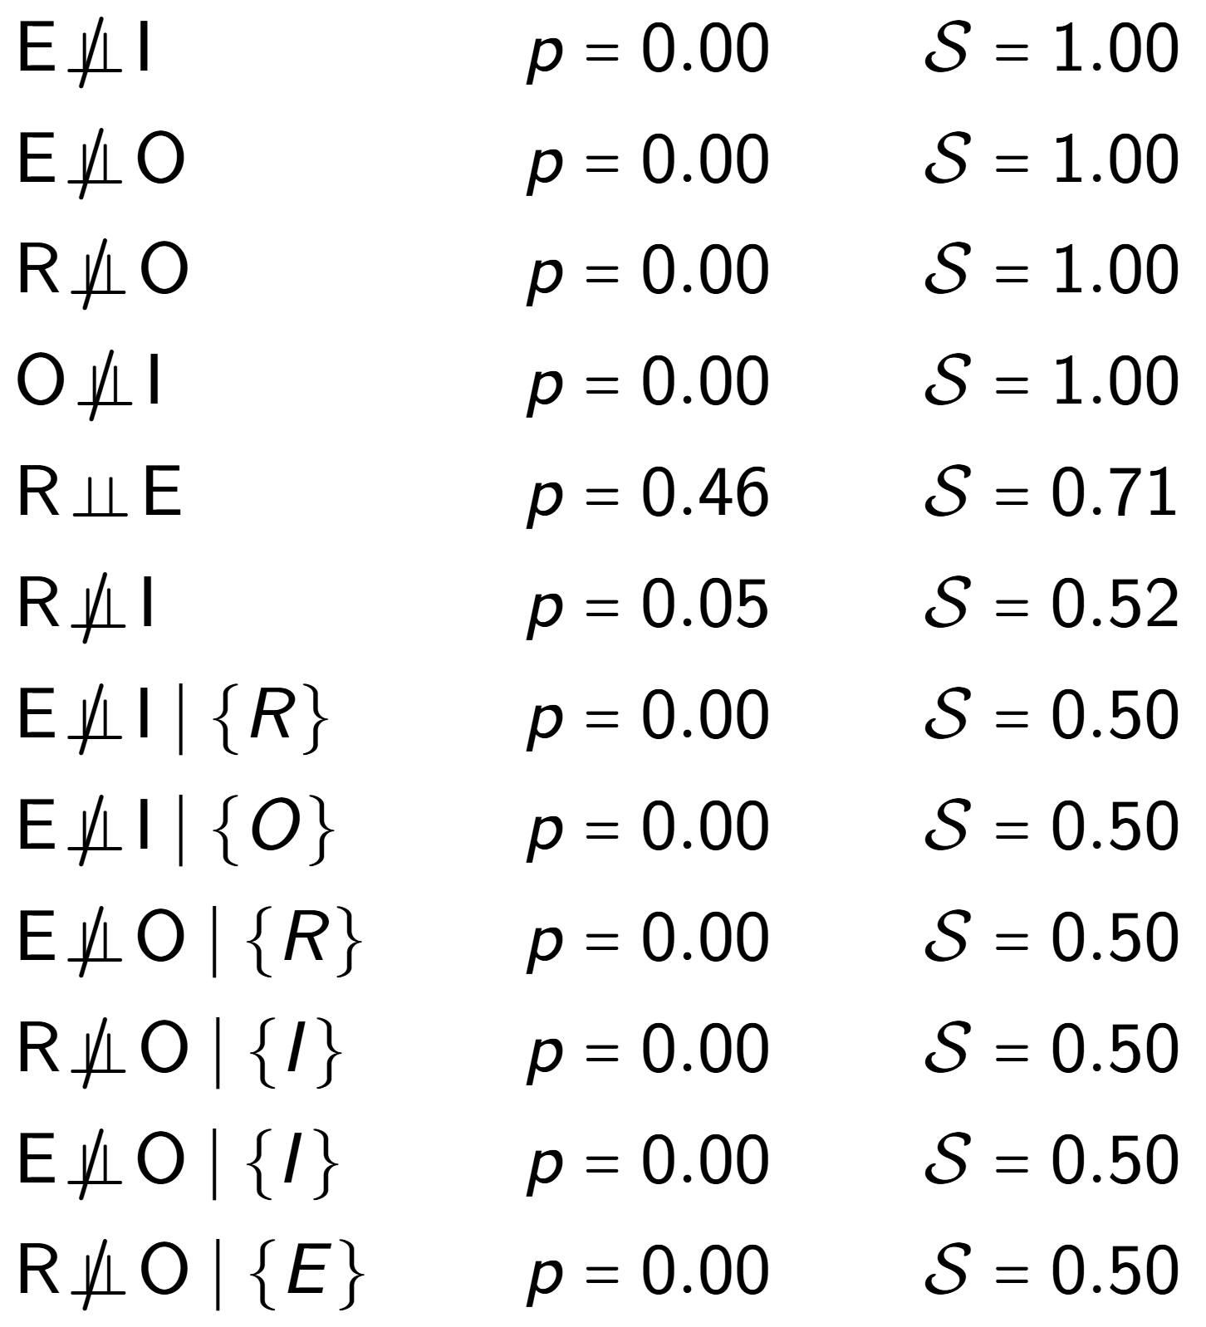
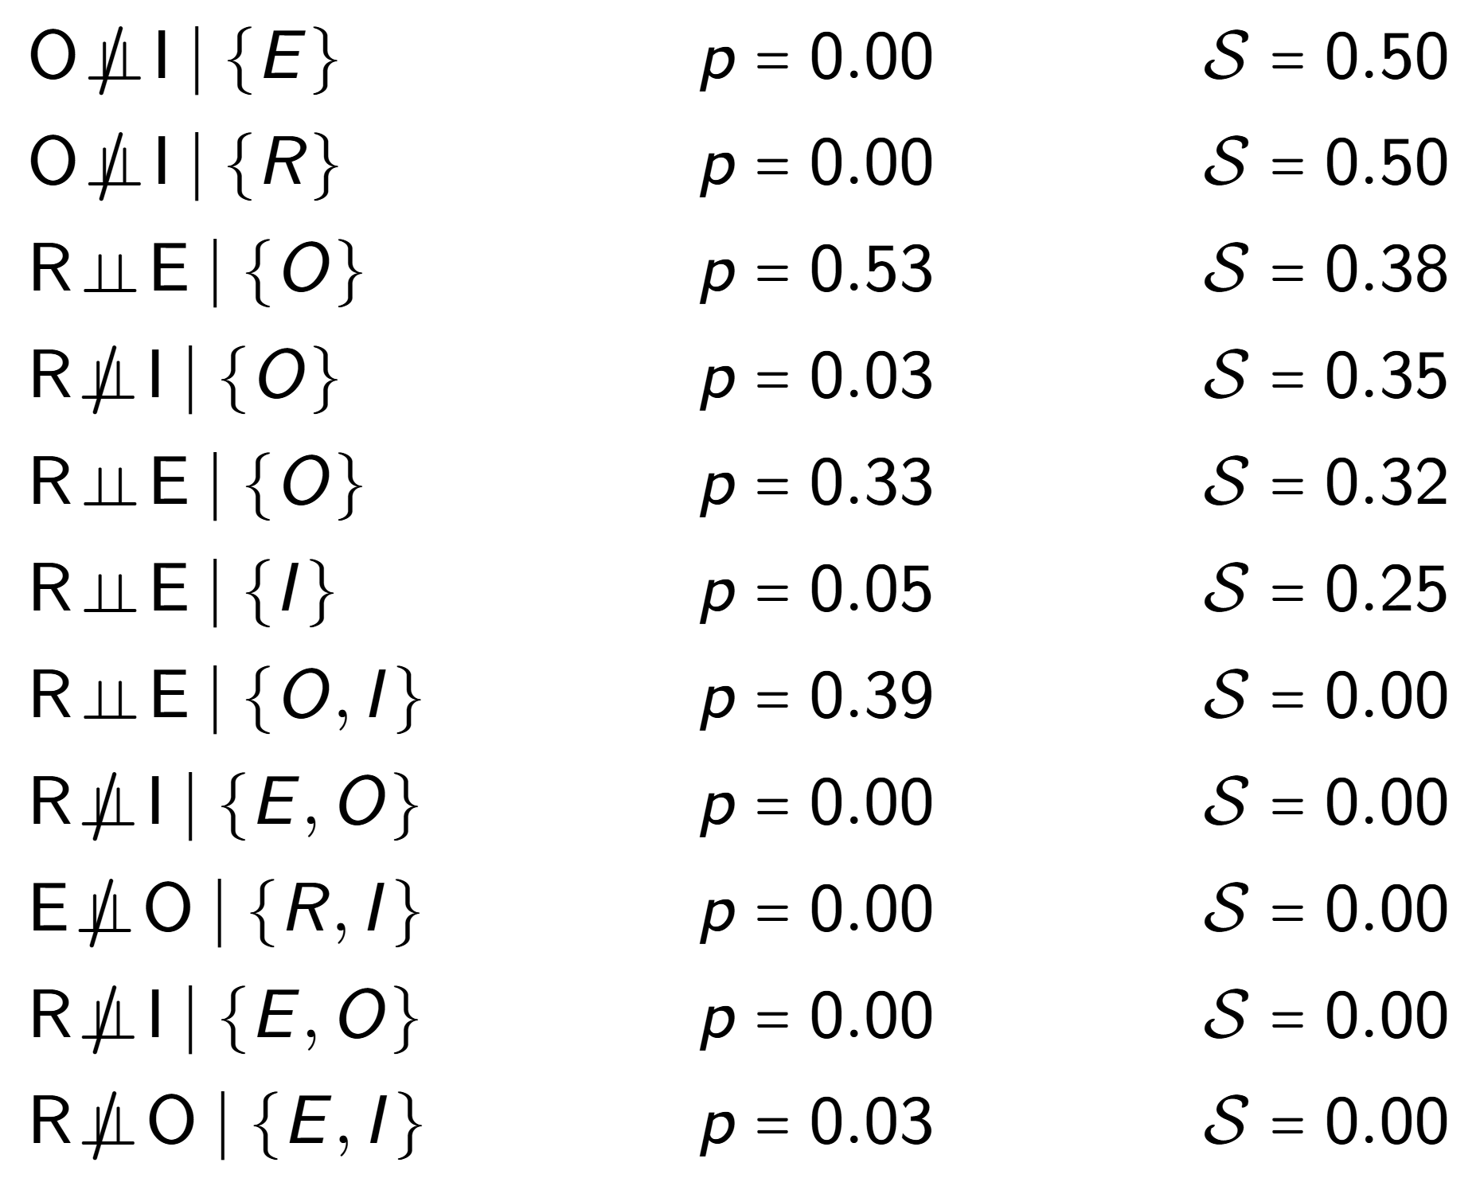
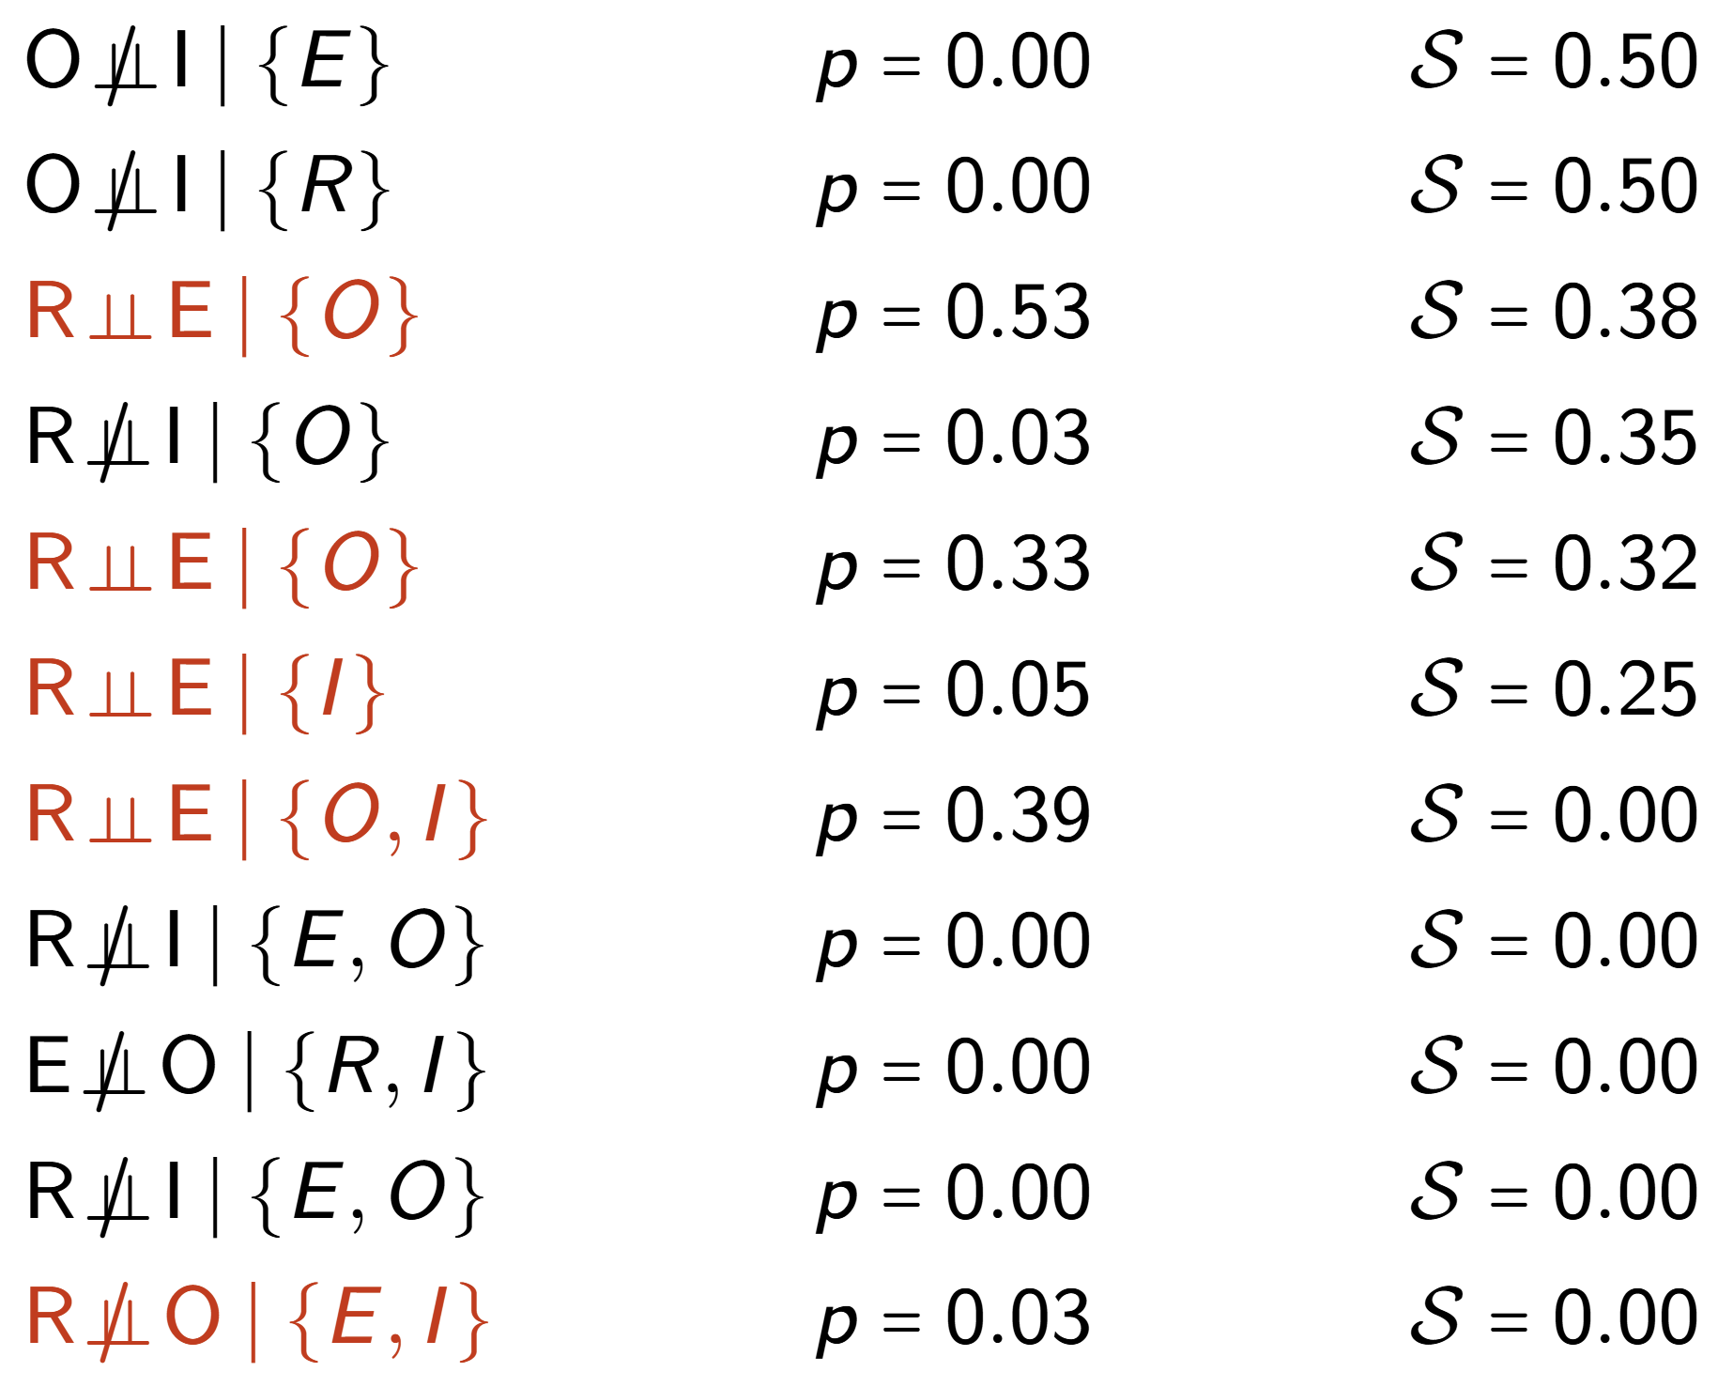
Income Prediction Example
Education
Occupation
Income
Race

Slide 25
Income Prediction Example
Education
Occupation
Income
True Causal Graph
Race
Education
Occupation
Income
Majority-PC (Colombo and Maathias, 2012)
Race
Education
Occupation
Income
Shapley-PC (Russo and Toni, 2025)
Race

Slide 26
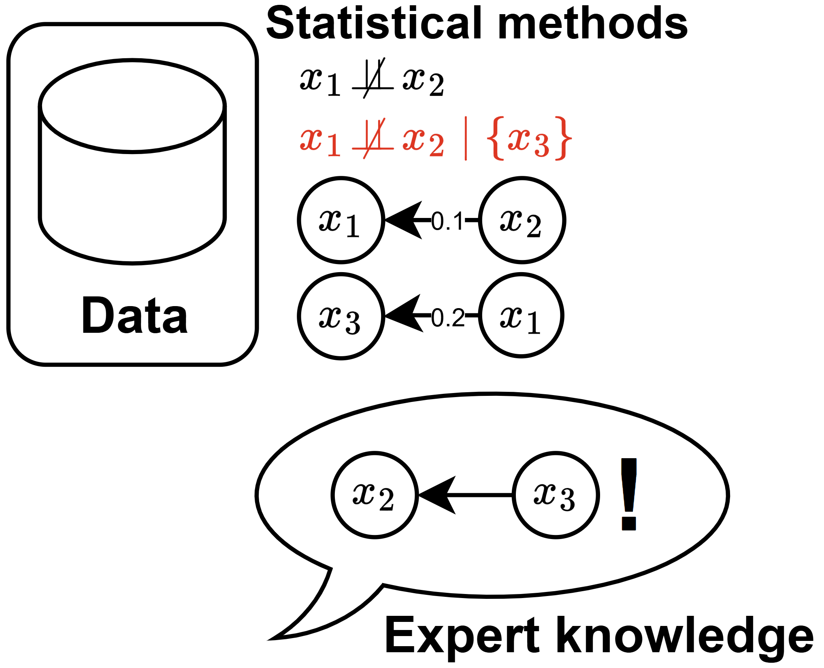
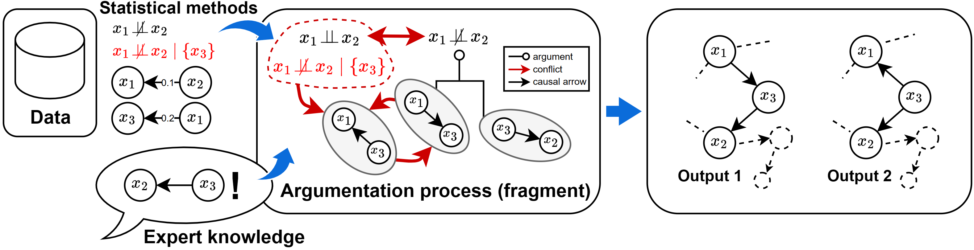
Argumentative Causal Discovery
A Debate about Causality

Slide 27
Income Prediction Example
Education
Occupation
Income
Race

Slide 28
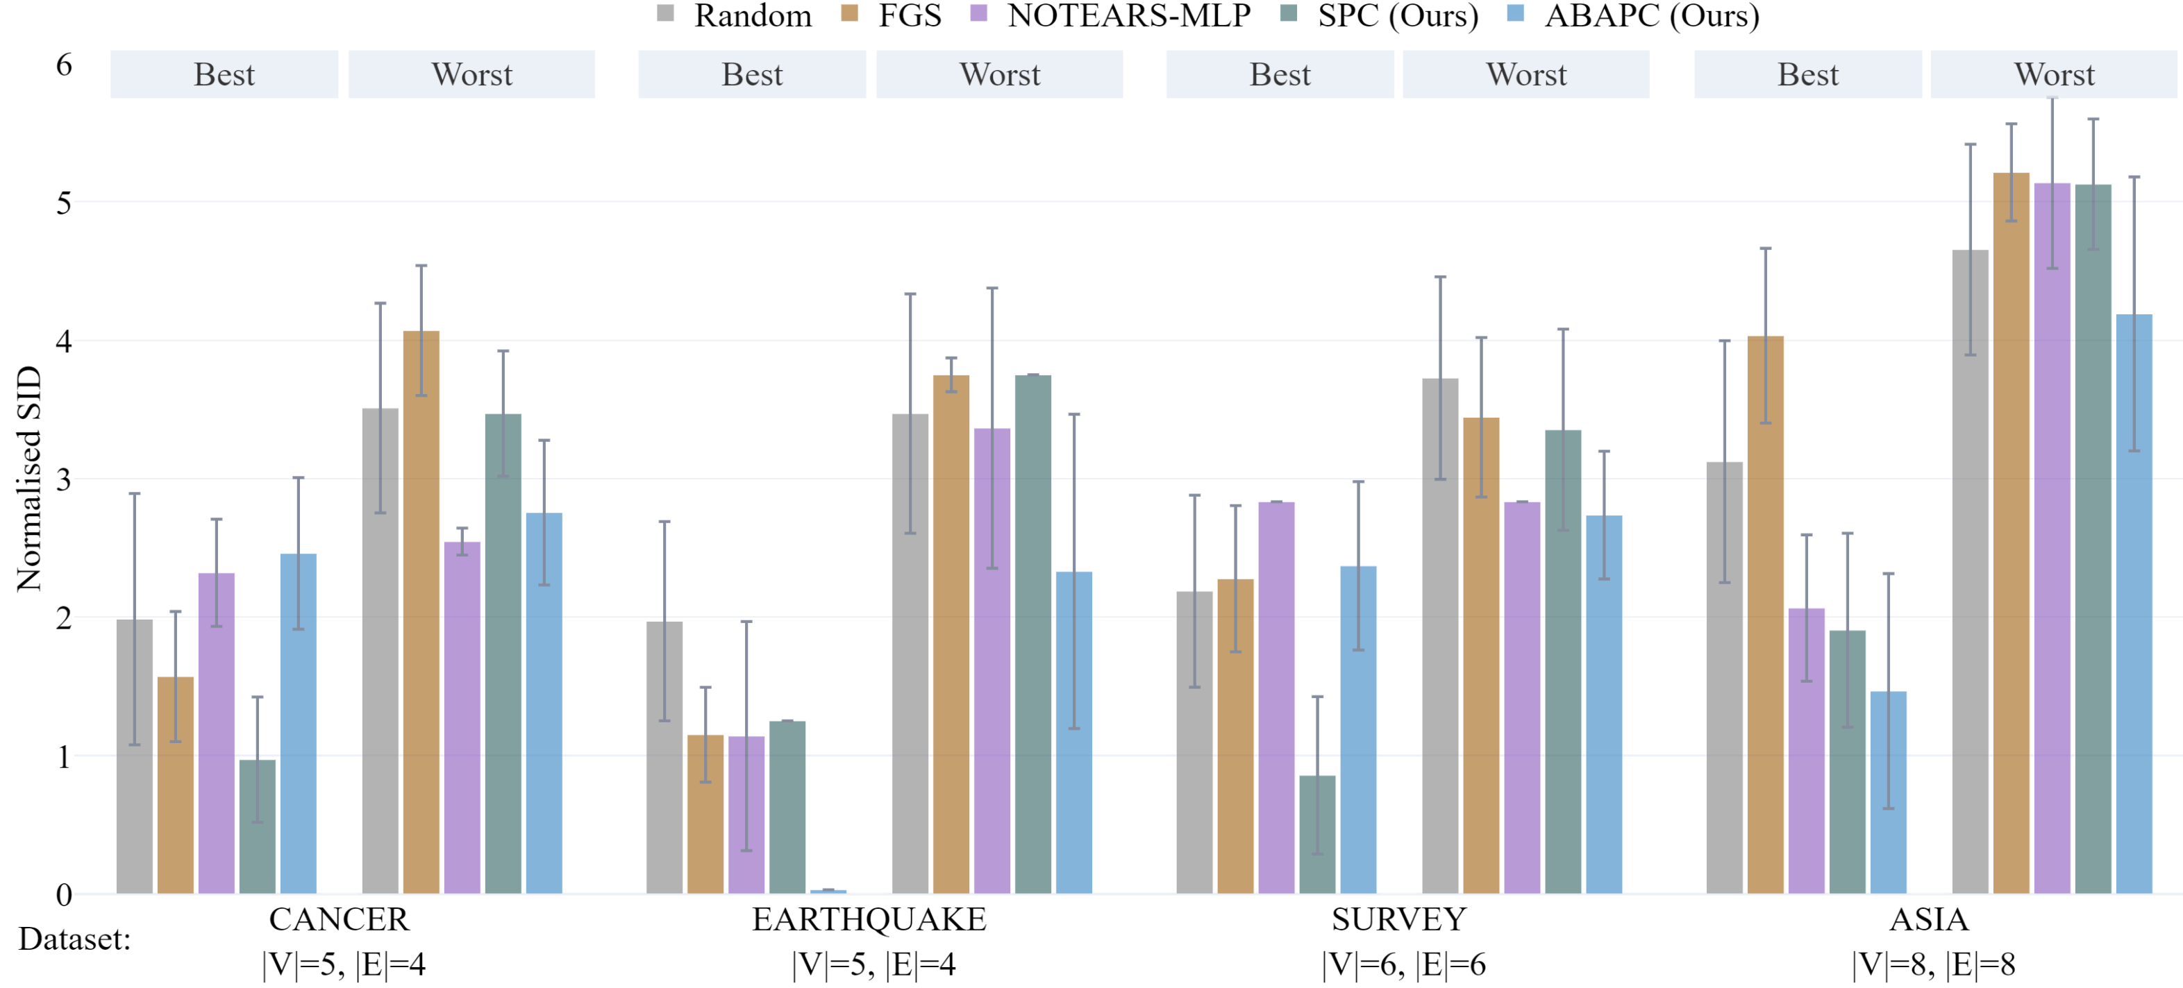
ABAPC Reconstruction Accuracy
on bnlearn datasets (Scutari, 2014)

Slide 29


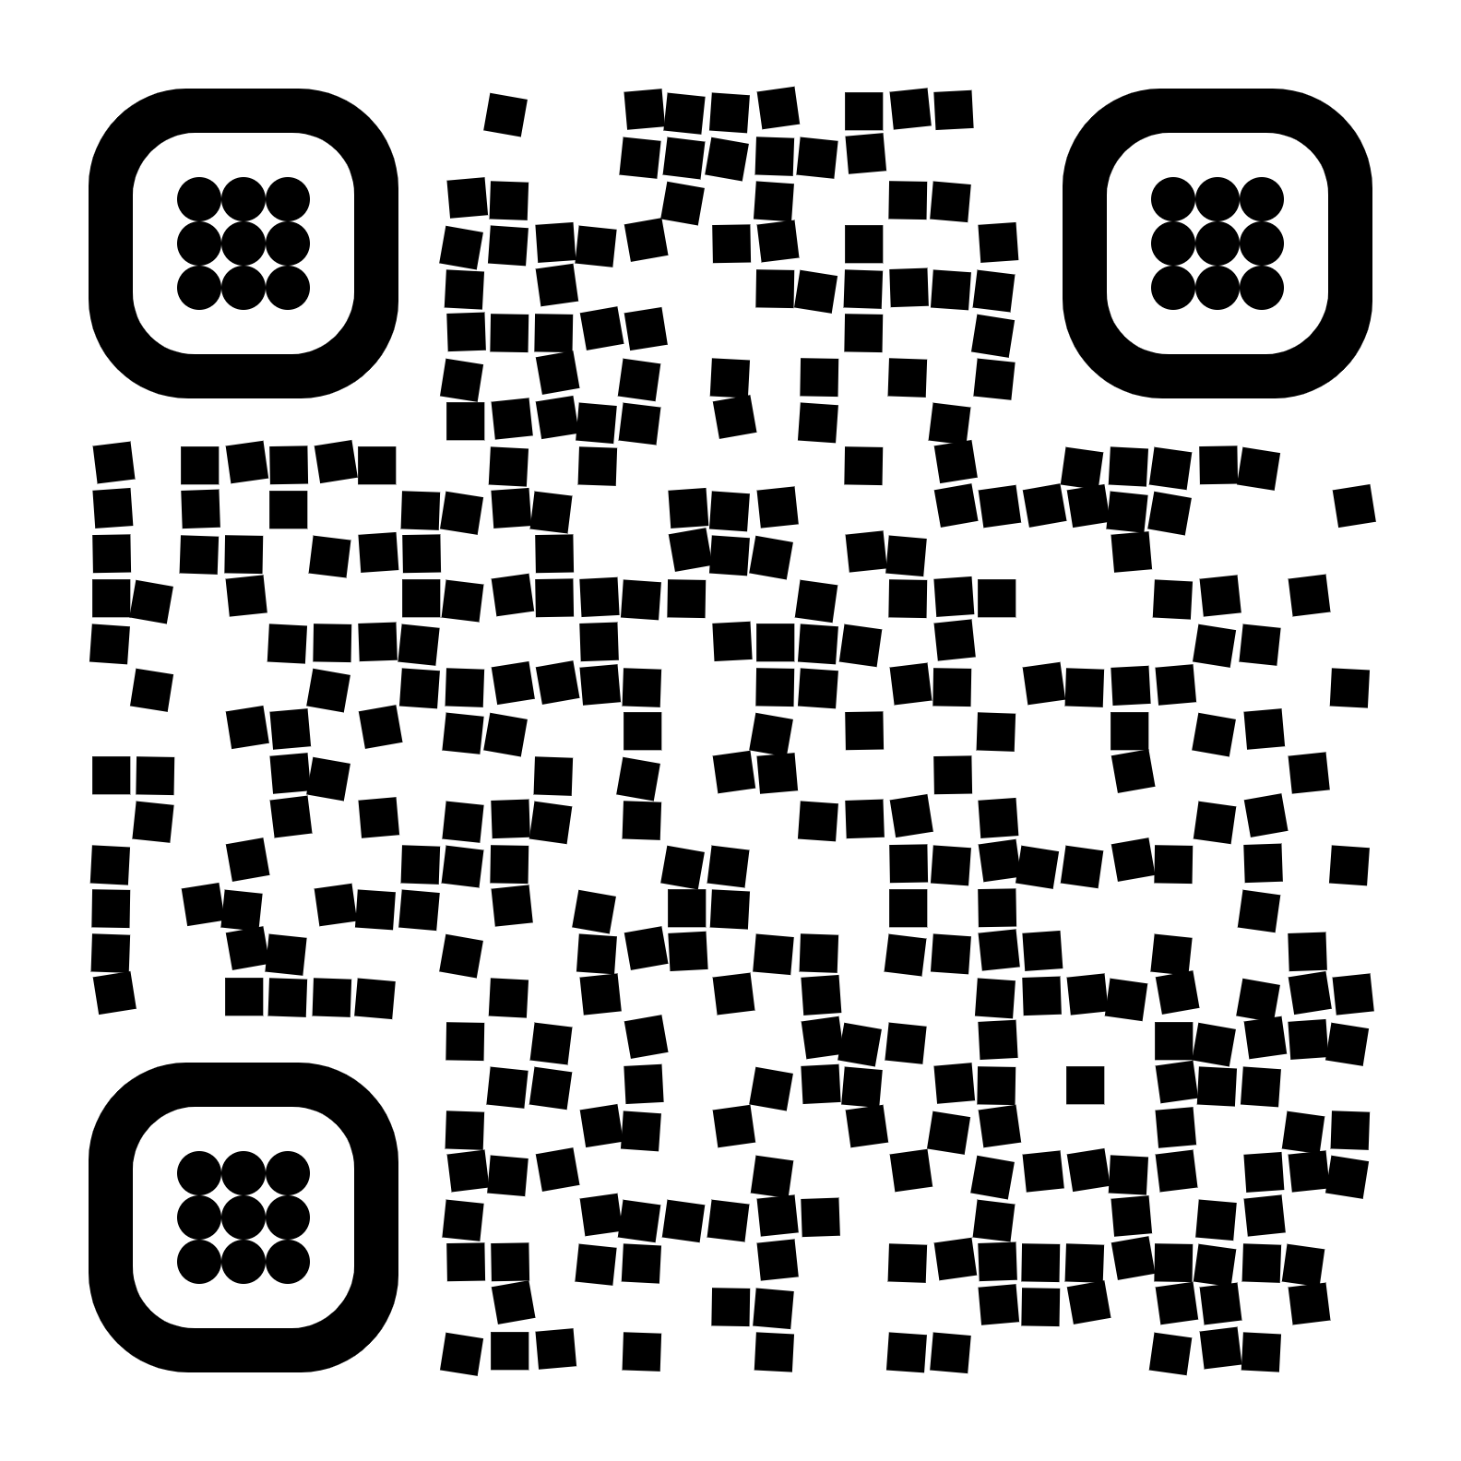
Argumentative Causal Discovery
Robust & Interactive
Sound & Complete
Robust to Errors but Computationally Demanding
Data Check &
Stakeholder Engagement
Russo, Rapberger & Toni. Argumentative Causal Discovery. In Proc. of KR 2024.

Slide 30

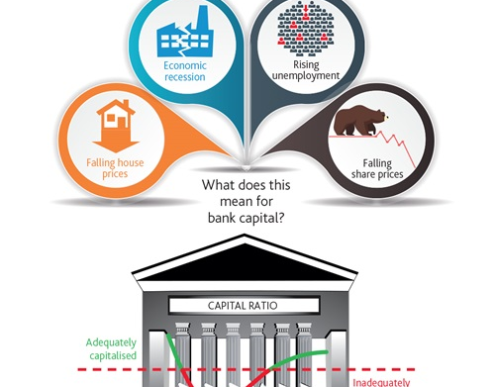
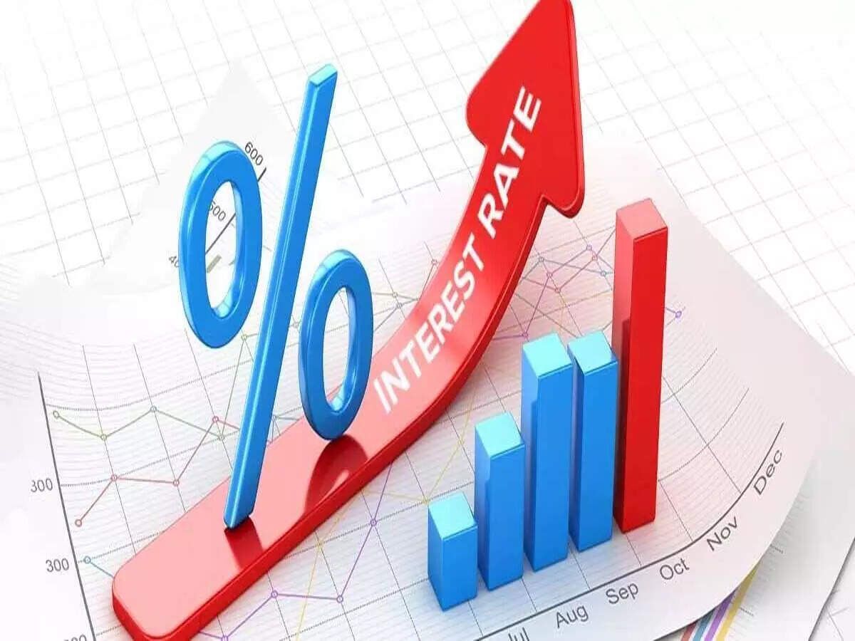
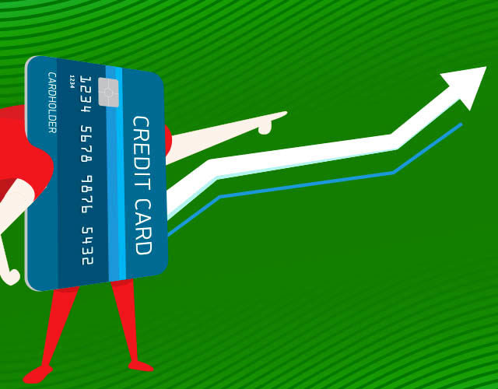
Endless Possibilities
What’s your most pressing use case?
Currently working on developing an interface for expert collaboration
ERC funding until June 2026 and starting collaborations in the fall

Slide 31

Questions?
Get in touch
fabrizio@imperial.ac.uk

Slide 32
Appendix

Slide 33
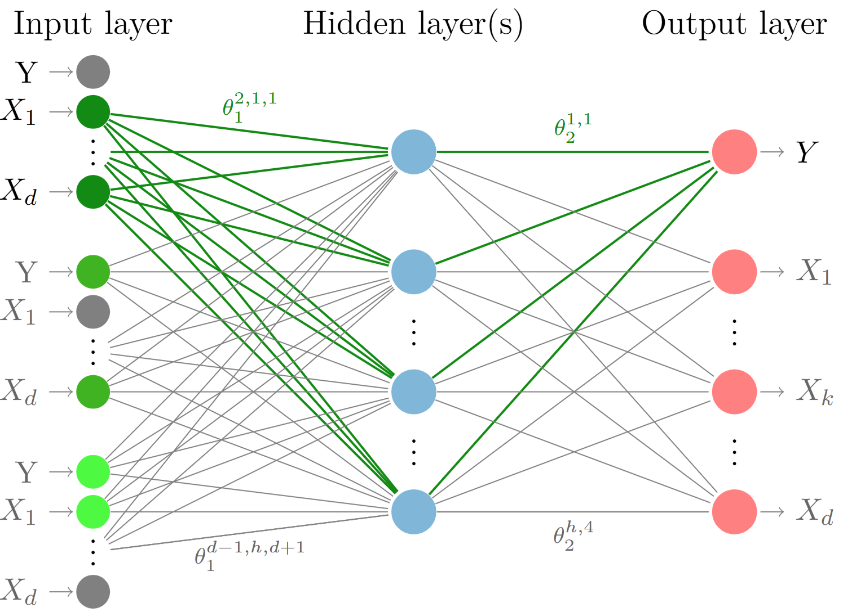
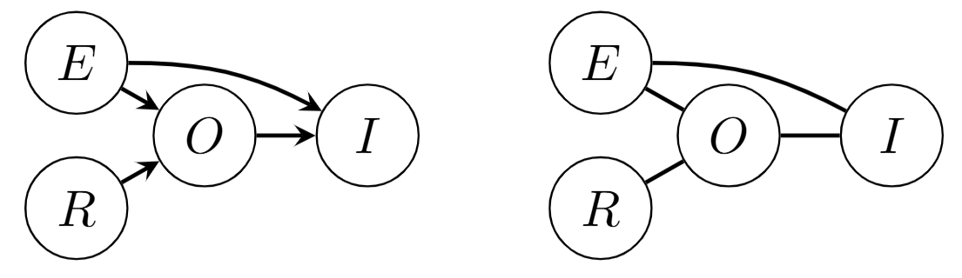
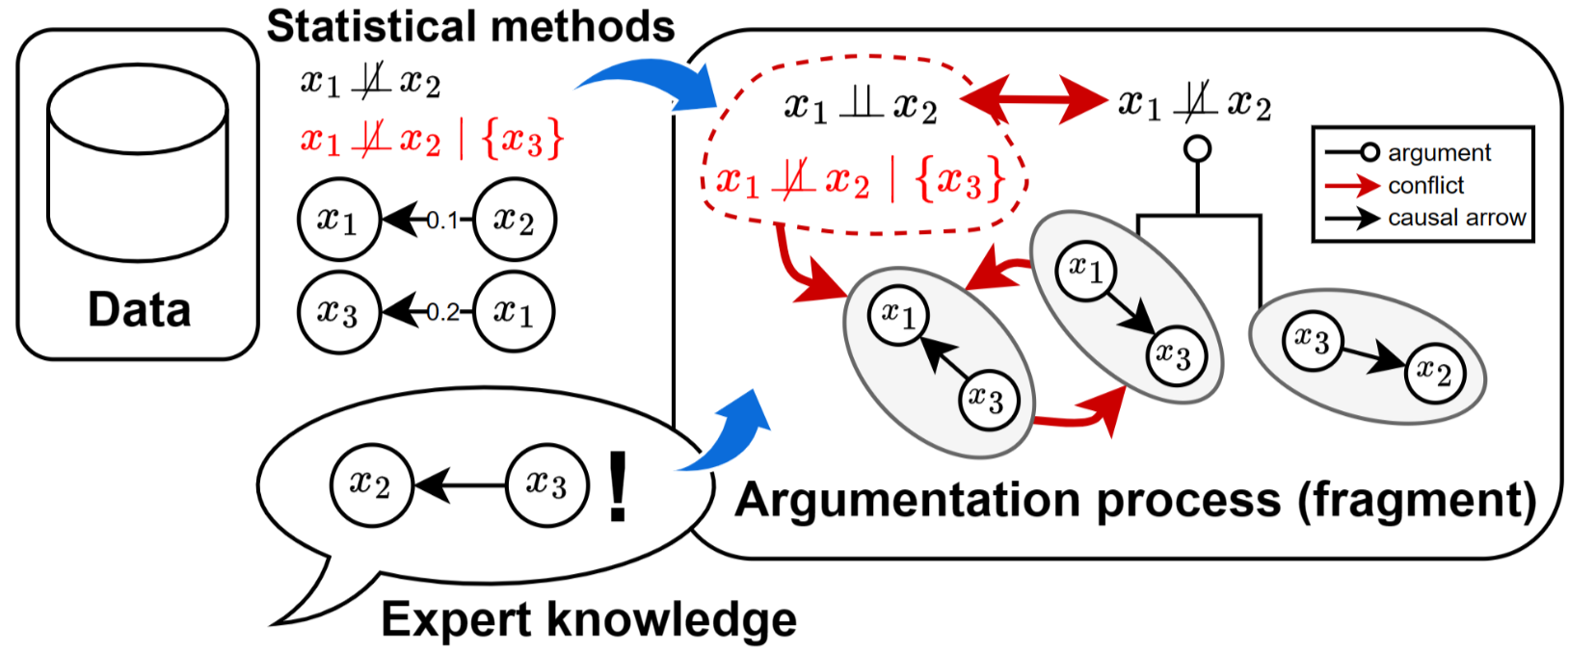
Causal Discovery for Trustworthy AI
Methods
Contestable Neural Networks
Causal Discovery with Shapley Values
Argumentative Causal Discovery
Expose the learned graph to SMEs and allow them to modify it
Inject the graph back into the NN
Learn a causal Graph while fitting a neural network
Embed the decision rule into the PC algorithm
Learn a causal graph with asymptotic guarantees
Identify colliders given a skeleton using Shapley Values
Represent DAGs and d-Separation as a debate
Allow external knowledge to be input into the framework
Guarantee consistency of output DAG with a subset of the input
Russo & Toni. Causal Discovery and Knowledge Injection for Contestable Neural Networks. In Proc. of ECAI 2023
Russo & Toni. Shapley-PC: Constraint-based Causal Structure Learning with a Shapley Inspired Framework. In Proc. of CLeaR 2025
Russo, Rapberger & Toni. Argumentative Causal Discovery. In Proc. of KR 2024.

Slide 34
Conclusions
& Future Work
Contestable NN
Method & Process to align NNs to SMEs’ causal view
Future: human studies, indirect effects, counterfactual reasoning
Shapley-PC
Method to improve robustness of causal discovery
Future: extend to other phases of PC, handle latent confounders, and score methods
Causal ABA
Method to increase consistency guarantees and allow contestability
Future: scalability, latent confounders, human studies

Slide 35
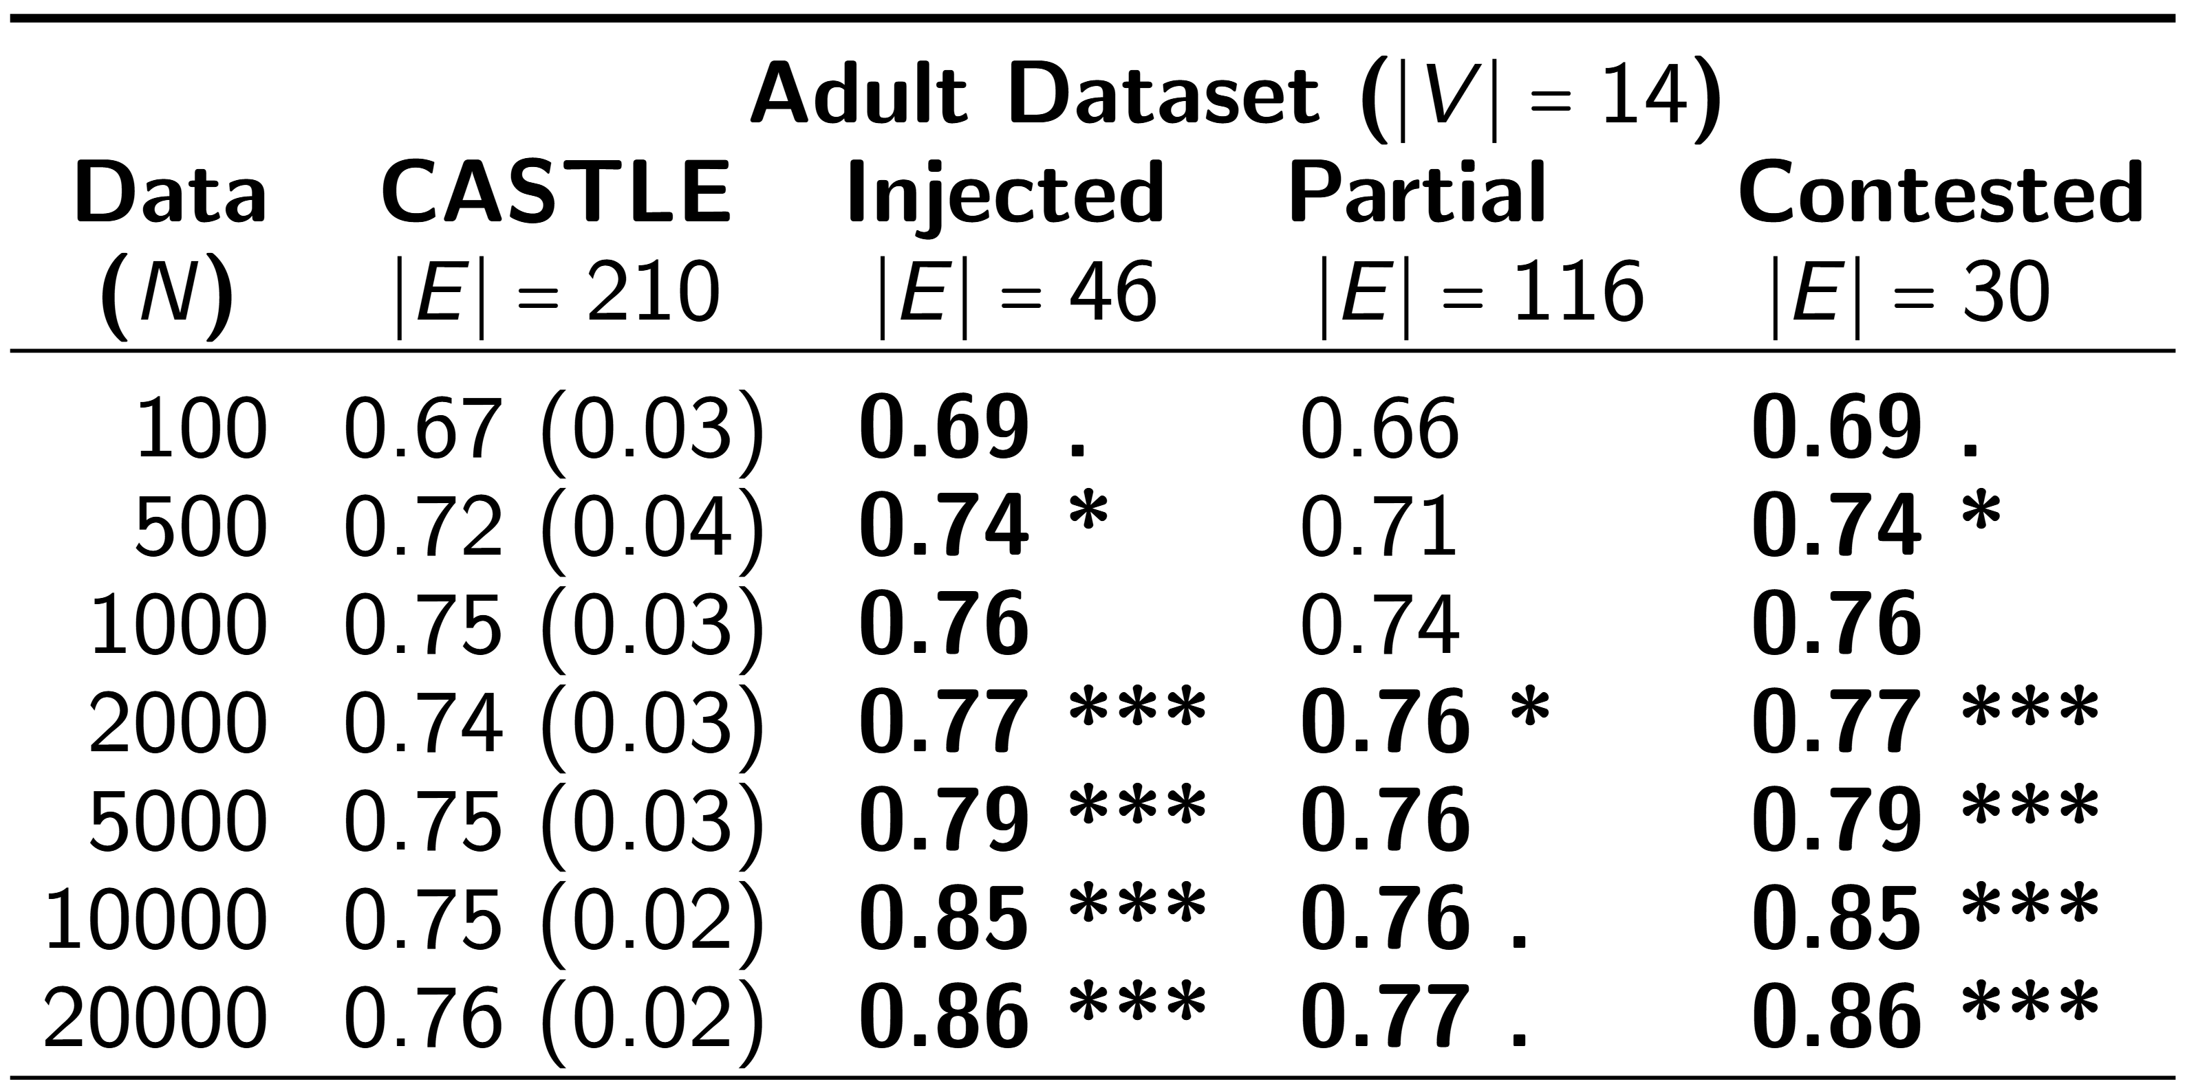
Income Prediction Case Study
Adult dataset (Becker and Kohavi, 1996) UCI repository

Slide 36
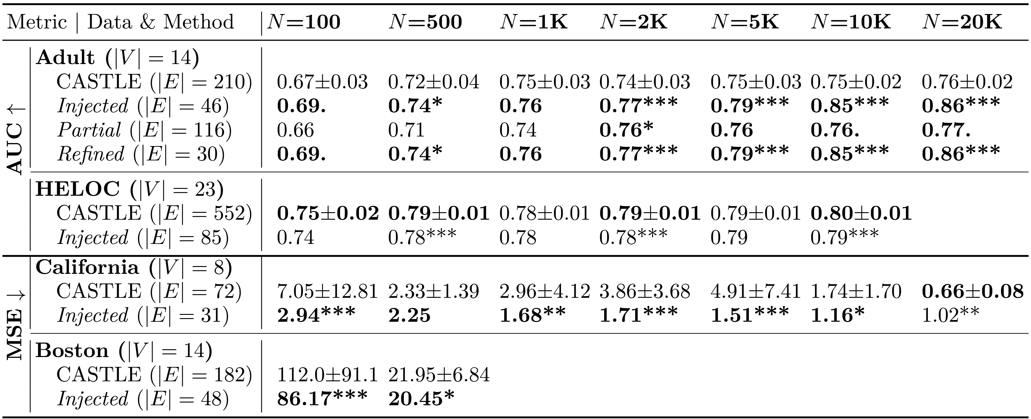
More Datasets
From Credit Risk to House Prices

